Slide 1
Improve Family Engagement
Promoting Meaningful and Equitable Family Engagement in Systems-Level Change

Slide 2
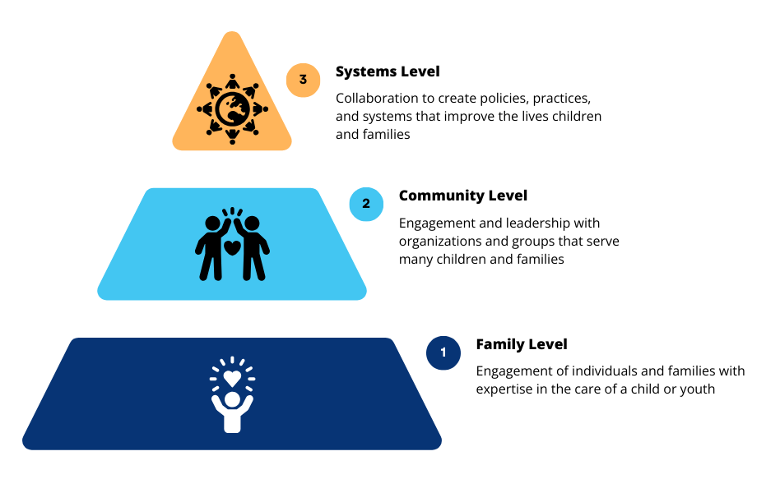
Levels of Family Engagement

Slide 3
Systems-Level Engagement

Slide 4
Three Uses of the FESAT

Slide 5
Use 3: Improve Family Engagement
The FESAT is a tool staff and families can score to improve family engagement in systems.
You may want to begin by completing the FESAT for a specific initiative.

Slide 6
Using the FESAT Score Sheet to Identify Areas to Improve

Slide 7
Commitment
Domain 1: Commitment
Notes:
Really impt to remember/remind the Title V that everyone who participated should score the tool within the context of the work they did

Slide 8
Transparency
Domain 2: Transparency

Slide 9
Representation
Domain 3: Representation
NOTE: If one or more of the four demographic characteristics in Domain 3: Representation, do not match your priorities for the populations served by the initiative you are assessing, you can replace them with criteria that do match your priorities. For example, your organization may be looking for family leaders of certain ages, race, disabilities, gender, sexual identity, etc.

Slide 10
Impact
Domain 4: Impact

Slide 11
Looking at the Consensus Score

Slide 12
Using Results
Identify domains of strength where families and staff felt supported in their role and had all the information and support they needed to partner and participate.
Identify domains for improvement where your organization could better support families and staff in their partnership roles so they can make meaningful contributions to the initiative.
Explore the FES Toolkit for strategies and resources to help the team improve family engagement in systems-level initiatives.
Create an action plan for improvement (Strategy 4.4 in the FES Toolkit).

Slide 13
FES Toolkit
The FES Toolkit includes one or more strategies that align with each item in the FESAT.
Many strategies work across one or more domains.
We update the FES Toolkit periodically with new strategies & resources.
You can suggest strategies & resources that are not currently include in the Toolkit.
We welcome suggestions for new strategies & resources to include.

Slide 14
Using the FES Toolkit

Slide 15
Using the FES Toolkit

Slide 16
Using the FES Toolkit

Slide 17
Using the FES Toolkit

Slide 18
Tools to Measure and Improve Family Engagement in Systems
The tools available at familyvoices.org/FESAT include:
User’s Guide
Family Engagement in Systems Assessment Tool (FESAT)
FESAT Score Sheet
Family Engagement in Systems Toolkit
The toolkit contains evidence-based strategies and resources that address each of the 20 items in the FESAT.

Slide 19
Learn more
Explore the four domains of the FESAT at familyvoices.org/FESAT/infographs.
Download the Family Engagement in Systems Assessment Tools at familyvoices.org/FESAT.
Request technical assistance to help your organization use the FESAT more effectively by emailing fesat@familyvoices.org.

Slide 20
Thank you!

