Slide 1
Assess Family Engagement
Promoting Meaningful and Equitable Family Engagement in Systems-Level Change

Slide 2
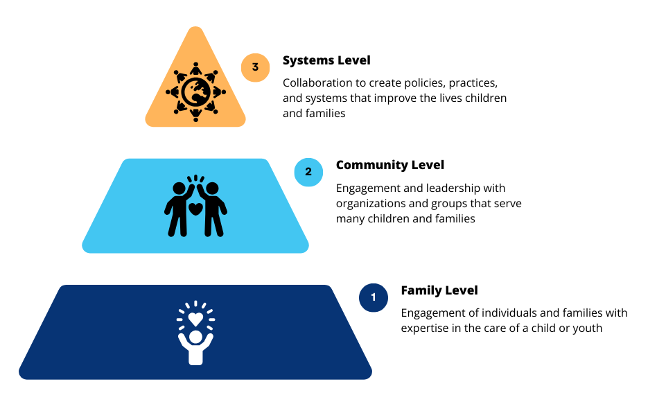
Levels of Family Engagement

Slide 3
Systems-Level Engagement

Slide 4
Three Uses of the FESAT

Slide 5
Use 2: Assess Family Engagement
The FESAT is a tool staff and families can score to assess family engagement in systems
You may want to begin with an ongoing systems-level initiative

Slide 6
Use 2: Assess Family Engagement
Describe the Initiative
Write a short description of the ongoing (or recently completed) systems-level initiative.
This might include improving an existing, or creating a new:
Policy
Program
Practice
Service
QI activity
Other initiative

Slide 7
Use 2: Assess Family Engagement
Describe the Initiative
[Organization] engages (or engaged) family members in
[short description of initiative] to [intended outcome].
A Title V program engaged family members in an initiative to improve care coordination services for CYSHCN to ensure services are family-centered, culturally appropriate, and reduce duplication.

Slide 8
Use 2: Assess Family Engagement
Scoring the FESAT
Staff and family participants score the tool
They can do this individually
More often, staff and families score the tool as separate groups
Both groups meet to discuss differing perspectives
They come to a consensus score for each item
REMEMBER
Respond to the items based on the work they did together.
Each person should score from own perspective/experience.
Do not enter a score for Not Sure/Not Applicable responses.

Slide 9
Use 2: Assess Family Engagement
FESAT Response Options
Never | Rarely | Sometimes | Usually | Always | Not Sure/ Not Applicable
0 | 1 | 2 | 3 | 4 | Do not score
An important note about the Not Sure/ Not Applicable Response
Do not enter a score
Points for the domain will automatically adjust based on the maximum number of points for the items scored

Slide 10
A Quick Review of the Family Engagement Domains

Slide 11
Domains of Family Engagement

Slide 12
What is commitment?
Commitment means family engagement is normalized and supported by policy throughout all activities that impact the organization at the systems level.
Does your organization have buy-in from all employees about the importance of engaging families at the systems level, valuing families’ time, and respecting their contributions?

Slide 13
Use 2: Assessing Commitment
Domain 1: Commitment
Notes:
Really impt to remember/remind the Title V that everyone who participated should score the tool within the context of the work they did

Slide 14
What is transparency?
Transparency ensures that all partners have access to the information they need to participate fulling in a process and be as effective as possible.
Does your organization provide supports and information in ways that help both families and professionals be informed participants in systems-level change?

Slide 15
Use 2: Assessing Transparency
Domain 2: Transparency

Slide 16
What is representation?
Representation is the engagement of family leaders who represent the diversity of the communities your organization serves or the scope of the problems your organization is looking to solve.
Does your organization partner with a family-led or community-based organization to help identify, support, and mentor family partners?

Slide 17
Use 2: Assessing Representation
Domain 3: Representation
NOTE: If one or more of the four demographic characteristics in Domain 3: Representation, do not match your priorities for the populations served by the initiative you are assessing, you can replace them with criteria that do match your priorities. For example, your organization may be looking for family leaders of certain ages, race, disabilities, gender, sexual identity, etc.

Slide 18
What is impact?
Impact describes data on what the organization is doing differently because of the engagement of families in systems-level change.
What is your organization doing differently because of engaging families at the systems level?

Slide 19
Use 2: Assessing Impact
Domain 4: Impact

Slide 20
Share Perspectives

Slide 21
Enter the consensus score

Slide 22
Tools to Measure and Improve Family Engagement in Systems
The tools available at familyvoices.org/FESAT include:
User’s Guide
Family Engagement in Systems Assessment Tool (FESAT)
FESAT Score Sheet
Family Engagement in Systems Toolkit
The toolkit contains evidence-based strategies and resources that address each of the 20 items in the FESAT.

Slide 23
Learn more
Explore the four domains of the FESAT at familyvoices.org/FESAT/infographs.
Download the Family Engagement in Systems Assessment Tools at familyvoices.org/FESAT.
Request technical assistance to help your organization use the FESAT more effectively by emailing fesat@familyvoices.org.

Slide 24
Thank you!

