Slide 1
Plan for Family Engagement
Promoting Meaningful and Equitable Family Engagement in Systems-Level Change

Slide 2
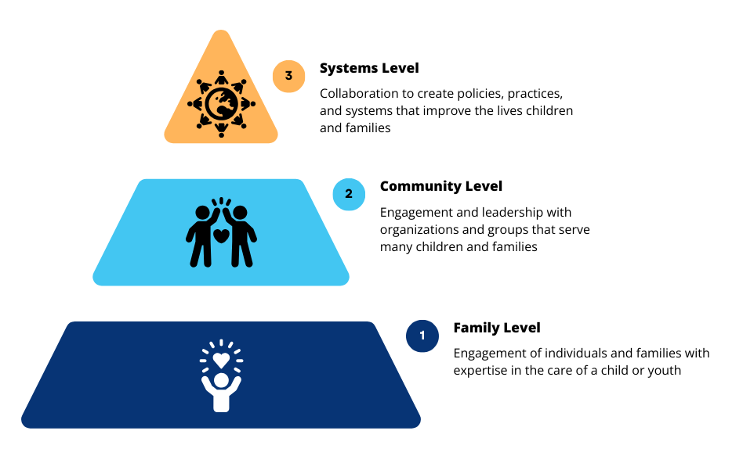
Levels of Family Engagement

Slide 3
Systems-Level Engagement

Slide 4
Tools to Assess and Improve Family Engagement in Systems
The tools available at familyvoices.org/FESAT include:
User’s Guide
Family Engagement in Systems Assessment Tool (FESAT)
FESAT Score Sheet
Family Engagement in Systems Toolkit
The toolkit contains evidence-based strategies and resources that address each of the 20 items in the FESAT.

Slide 5
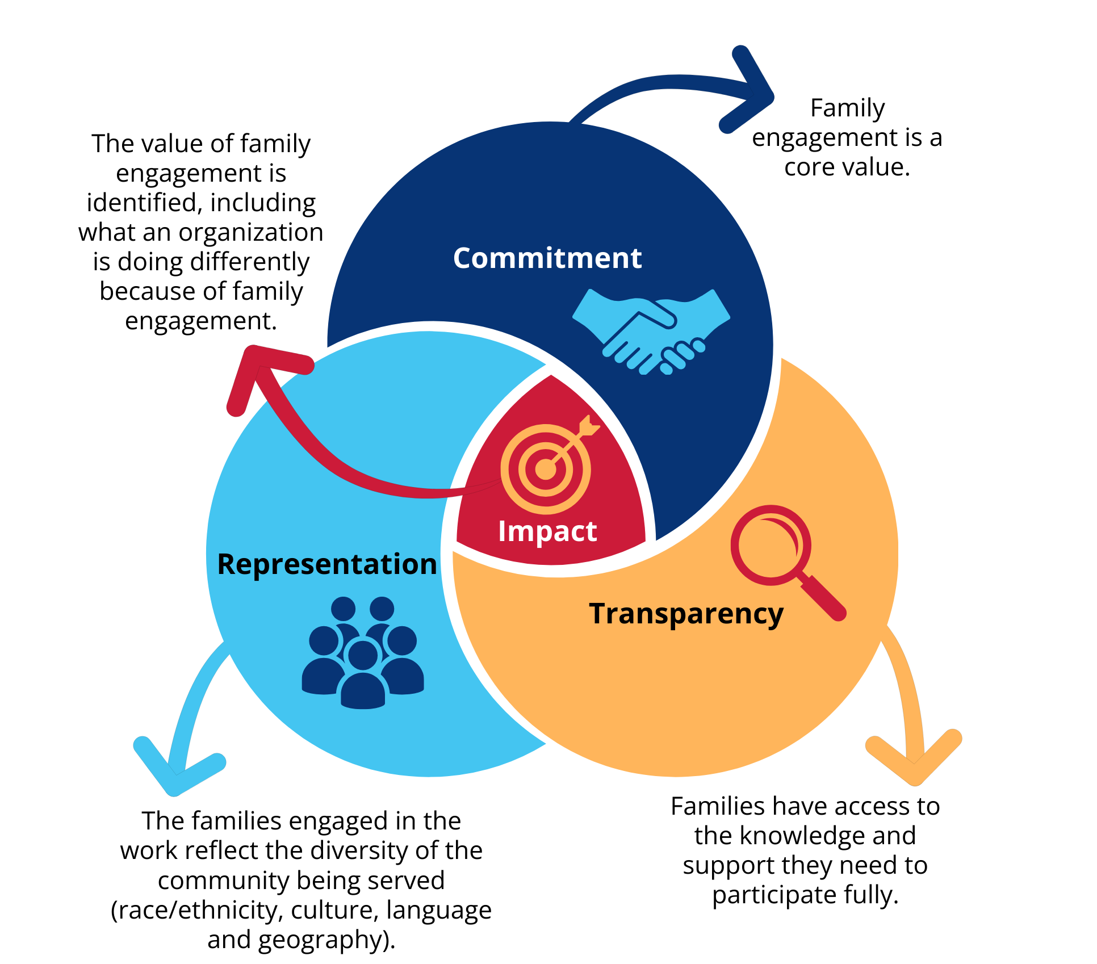
Framework for Family Engagement

Slide 6
Three Uses of the FESAT

Slide 7
Checklist to Plan a Family Engagement Initiative

Slide 8
Checklist to Plan a Family Engagement Initiative
Example: Using Google Jamboard to complete the Family Engagement Checklist
Notes:
https://jamboard.google.com/d/1xVOyw85S6ymwimV3CC8Z9KeFlIeqn2SkN5A8zrSpicU/viewer?f=0

Slide 9
Commitment
Commitment means an organization always engages families they serve in decision-making groups that are working to improve or create the policies, programs, and services that children, youth, and families receive.
Have a Policy
Have a family engagement policy that requires family engagement in systems-level initiative.
This sets a standard that families need to have role in creating or improving policies.
Ensures policies are family-centered and equitable.
Leadership and Compensation
Family Engagement champions
Have one or more staff members lead the way for those who may not understand the value of family partnership.
Compensate family partners
Recognizes the value of families’ time, experience, & expertise.
Ensures equity, as many families cannot take time away from work and family.

Slide 10
Commitment
Strategy 1.1: Create a written policy that requires family engagement in systems-level initiatives
Example 1:
Supporting Patient and Family Engagement: Best Practices for Hospital Leaders is an evidence-based guide, developed by U.S. Department of Health and Human Services’ Agency for Healthcare Research and Quality. While created for hospitals, the strategies, such as including family engagement in the hospital’s mission and vision statements, and strategic plan, can be used by any child- and family-serving organization to guide the design of a written policy for engaging families in systems-level initiatives.

Slide 11
Commitment
Strategy 1.1: Create a written policy that requires family engagement in systems-level initiatives
Example 2:
Policy Statement on Family Engagement from the Early Years to the Early Grades, from the U.S. Department of Health and Human Services, U.S. Department of Education.

Slide 12
Commitment
Strategy 1.1: Create a written policy that requires family engagement in systems-level initiatives
Example 3:
Developing a Written Parent and Family Engagement Policy: A Guide for Districts and Schools. This 2018 document from the Tennessee Department of Education includes tools and resources for writing family engagement policies for engaging families at the advisory/district level, beyond the education of their individual child.

Slide 13
Transparency
Transparency occurs when an organization documents and communicates how it identifies issues families experience and provides the information and supports families and staff need to partner, participate, and contribute to their maximum potential.
Identify the Issues
Use internal data or partner with family-led or community-based organizations to learn what they are hearing from families.
Co-create needs assessments, surveys, other feedback loops.
Reach families directly
Uses data from a variety of sources.
Provide Information and Support
Describe the opportunity.
Moves families “beyond the checkbox.”
Provide mentors
To help families & staff prepare for meetings.
To help families learn to use their experiences to improve systems of care for all families.
Share meeting materials in advance.
Jargon free

Slide 14
Transparency
Strategy 2.4: Make sure all participants (family leaders and organization staff) have the information and supports they need to participate to their maximum potential.
Example 1:
A Roadmap for Patient + Family Engagement in Healthcare: Practice and Research documents the supports families (pages 17 & 18 of the Roadmap) and health care staff (pages 22 & 23 of the Roadmap) need to collaborate in systems-level activities. This includes plain language materials that describe the opportunity, mentorship, and training so everyone has background information and context for the initiative and understands his or her role and decision-making power.

Slide 15
Transparency
Strategy 2.4: Make sure all participants (family leaders and organization staff) have the information and supports they need to participate to their maximum potential.
Example 2:
Create a job description so families have a clear understanding of their role and the value of the initiative.

Slide 16
Transparency
Strategy 2.4: Make sure all participants (family leaders and organization staff) have the information and supports they need to participate to their maximum potential.
Example 3: If the organization is reaching out to a family-led organization to help recruit family leaders to participate in an initiative, provide details about:
The purpose and goals of the project.
Expectations for the family leaders and staff; expected timing and length of commitment.
Meeting logistics (for example time, place, frequency, virtual, other).
Compensation or other remuneration.
Expected skills, such as use of Excel, experience with qualitative or quantitative analysis, comfort speaking up in a group or giving presentations, contributing to reports, and so on.
The Oregon Center for Children and Youth with Special Health Needs has an excellent worksheet for Planning For Meaningful Family Involvement.

Slide 17
Representation
Representation occurs when the families who are engaged in the initiative reflect the diversity of the community served by the organization.
Equal Representation
Engaged families reflect the diversity of those served by a specific systems-level initiative.
Use internal or external data to understand the demographics of families served.
Connect with a family-led or community-based organization that supports families who are diverse.
Provide Support
Provide mentoring & skill-building opportunities for both families and staff. Examples:
Workshops about parent-professional partnerships.
Implicit bias training so all participants are aware of assumptions they may make.

Slide 18
Representation
Strategy 3.3: Provide mentoring and skill-building opportunities for the families and organization staff who participate in systems-level initiatives.
Example 1:
Many Family Voices Affiliate Organizations and Family-to-Family Health Information Centers provide support, mentorship, and skill-building opportunities for families and their professional partners. This helps to ensure meaningful engagement in systems-level initiatives. See Overarching Strategy to Promote Family Engagement in Systems (FES Toolkit, page 10)

Slide 19
Representation
Strategy 3.3: Provide mentoring and skill-building opportunities for the families and organization staff who participate in systems-level initiatives.
Example 2:
Family Engagement and Leadership in Systems of Care, funded by the Maternal and Child Health Bureau, provides national leadership on family engagement to support youth and family leaders, Maternal and Child Health (MCH) programs, and other stakeholders that serve children and youth with special health care needs (CYSHCN).

Slide 20
Representation
Strategy 3.4: Child- and family-serving organizations, organization staff, family leaders, and other stakeholders should be aware of their personal biases when engaging in systems-level initiatives.
Example 3:
Project Implicit is a 501(c)(3) non-profit organization and international collaborative of researchers who are interested in implicit social cognition. The goal of their work is to educate the public about bias and to provide a “virtual laboratory” for collecting data on the internet. Users can take tests anonymously to explore their own implicits biases in multiple domains.

Slide 21
Impact
Impact describes how and where the organization used families’ input and ideas to improve existing policies and practices or to create new ones.
Listen
Families know what works and what doesn’t work about systems of care.
Listen to their lived experiences.
Work together to identify areas for improvement.
Work together to identify solutions.
Identify what has changed
Staff and families can identify what the organization is doing differently because families were engaged in the initiative.
Document families’ contributions to the work.
If needed, work together to create an action plan to improve family engagement in systems-level initiatives.

Slide 22
Impact
Strategy 4.4: Develop an Action Plan to plan a meaningful family engagement initiative.
Organizations that complete the FESAT and identify domains for improvement should work with family leaders to develop an action plan to improve family engagement.
Example 1:
The Center for Community Health and Development at the University of Kansas has a Community Tool Box, which includes a section on Developing an Action Plan.

Slide 23
Impact
Strategy 4.4: Develop an Action Plan to plan a meaningful family engagement initiative.
Organizations that complete the FESAT and identify domains for improvement should work with family leaders to develop an action plan to improve family engagement.
Example 2:
The Free Management Library has thousands of tools that help facilitate organizational change, including the Basics of Action Planning.

Slide 24
Impact
Strategy 4.4: Develop an Action Plan to plan a meaningful family engagement initiative.
Organizations that complete the FESAT and identify domains for improvement should work with family leaders to develop an action plan to improve family engagement.
Example 3:
The S.M.A.R.T. Objectives Worksheet from Wayne State University provides step-by-step instructions for developing action plans.

Slide 25
Impact
Strategy 4.4: Develop an Action Plan to plan a meaningful family engagement initiative.
Organizations that complete the FESAT and identify domains for improvement should work with family leaders to develop an action plan to improve family engagement.
Example 4:
The Massachusetts Libraries Board of Library Commissioners has an Action Plan Template.

Slide 26
Resources
Download the Family Engagement in Systems Assessment Tools
Issue Brief: Moving Beyond the Family Engagement Check Box
Request technical assistance from Family Voices

Slide 27
Thank you!

