Slide 1
Creating Effective Outreach Campaigns
Notes:
1. Slide Time: 1 min / Total Time 1 min
Say: Welcome to today's session, as part of our Public Health Emergency Unwinding series. Today, we are talking about Creating Effective Outreach Campaigns.

Slide 2
Navigating Redetermination with
Special Populations
INSERT THE NAMES OF PRESENTERS HERE
Please share your name, state and the organization you represent by typing it into the chat.
Notes:
2. Slide Time: 2 min / Total Time 3 min
Do: Allow time for each presenter to introduce themselves.

Slide 3
Project Overview
Family Voices was awarded funding from the Lucile Packard Foundation and Maternal Child Health Bureau (MCHB) to help families understand and address issues related to the unwinding of the Public Health Emergency.
Many families of medically complex children are impacted by the Medicaid unwinding. Family Voices will work with the F2F/AOs, Manatt and other partners to reach out to families from the national network to support understanding the process and changes.
This project is supported, in part, by the Health Resources and Services Administration (HRSA) of the U.S. Department of Health and Human Services (HHS) as part of an award totaling $650,000. The contents are those of the author(s) and do not necessarily represent the official views of, nor an endorsement, by HRSA, HHS, or the U.S. Government. For more information, please visit HRSA.gov.
Notes:
3. Slide Time: 1 min / Total Time 5 min
Say: Family Voices was awarded funding from the Lucile Packard Foundation and Maternal Child Health Bureau (MCHB) to help families understand and address issues related to the unwinding of the Public Health Emergency. Many families of medically complex children are impacted by the Medicaid unwinding. Family Voices will work with the F2F/AOs, Manatt and other partners to reach out to families from the national network to support understanding the process and changes.

Slide 4
Objective
Learn the distinction between passive and active outreach.
Understand the six parts of the outreach cycle and how to use this model to increase community impact.
Describe effective strategies for building a culture of outreach within an organization.
Notes:
4. Slide Time: 1 min / Total Time 6 min
Say: This session is part of our Stay Covered! initiative to help families understand the end of the public health emergency and the impact of this event on the Medicaid renewal process. At the end of today’s session, participants should understand the public health emergency and the implications of the public health emergency coming to an end. We will also learn about programs and commonly used terms that are important when supporting families who are impacted by the end of the public health emergency. Finally, we will explore the impact that the end of the Public Health Emergency is having on families across the country.

Slide 5
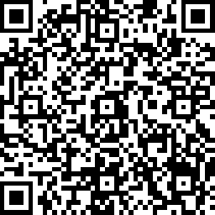
Pre-Session Questions
https://www.surveymonkey.com/r/StayCoveredMod5Pre
Notes:
5. Slide Time: 3 min / Total Time 9 min
Say: If you haven’t already, please use the QR code above or the link in the chat to complete the pre-session questions. It should only take a minute or two and we will pause here to give everyone that opportunity.
Share in Chat: https://www.surveymonkey.com/r/StayCoveredMod5Pre

Slide 6
Defining Outreach
Notes:
6. Slide Time: 1min / Total Time 10 min
Say: What is outreach? This may seem like a straightforward answer, and yet, in my experience working with programs, outreach strategy is always one of the most frequently requested support topics. So, what is outreach? In the chat, give a few words or a sentence that will give us an idea of your definition for outreach.
Do: Wait and read off a few of the answers.

Slide 7
Defining Outreach
Outreach is sharing information to increase awareness of available services.
Notes:
7. Slide Time: 1min / Total Time 11 min
Say: In its simplest form, outreach is sharing information to increase awareness of available services. That is a straightforward definition of outreach, used by many people and programs, but is it a definition that works to get us the results we want? Probably not. If our outreach efforts were entirely and completely successful, we wouldn’t have as many conversations as we do about outreach. But why isn’t it working? Don’t families want the information we have to give them? We’ve made it available on our website, so they’ll find it when they need it, right? The type of outreach we are talking about here is one level of outreach, but it isn’t the level where we should be focusing attention.

Slide 8
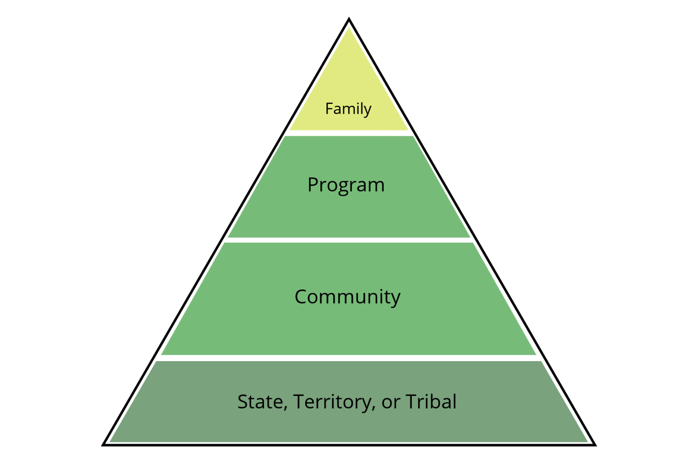
Defining Outreach
Notes:
8. Slide Time: 1min / Total Time 12 min
Say: Outreach occurs at multiple levels, and each has its own purposes. Family to family outreach is what we are probably all most familiar with, and the type of outreach we just defined. Family outreach is organic and stems from personal connections. An example might be a parent who sees information about a program being done by a local health center in their social media feed and they share that information to their own timeline or verbally with friends or neighbors. Family outreach is influenced by materials produced by states, territories, tribal nations, local communities and programs, because most of the information, resources and materials that families share comes from those sources. This type of outreach is very effective, because it is based on personal connections and personal interests. The challenge for programs, communities, states, territories, and tribal nations is that before parents can share the information, we must get the information to the parents. For some families, outreach is easy. They have large presence on social media, their kids bring home every flyer they get at school, and they tune into local outlets that share events and resources. These families know where to go when they need things, and they don’t need a lot of help or resources anyway. These families are also usually really great about reaching out to get the resources they need and will likely share those with other families. These families become our "go to" families. Unfortunately, most families are not this tuned into resources available. We typically think of these families as “hard to reach” and we spend a lot of time and effort trying to find ways to reach them, but often without much success. Now, what happens when we shift the way we think of this and redefine outreach.

Slide 9
Redefining Outreach
Hard-to-Reach Families
Hard-to-Reach Services
U.S. Department of Health and Human Services, Administration for Children and Families, Office of Head Start, National Center on Parent, Family, and Community Engagement. (2020). Family Outreach Series—Strategies for Outreach to All Families: Overview (2nd ed., rev.). Family Outreach Series Strategies for Outreach to All Families: Overview (2nd ed., rev.)
Notes:
9. Slide Time: 1min / Total Time 13 min
Say: What happens if we make a simple shift in the narrative and move from describing families as hard for us to reach, and instead think of our services and resources as hard for families to reach. I wish I could take credit for this idea, but it comes from the National Center on Parent, Family and Community Engagement, and the citation for that source is on your screen. They have a wonderful Family Outreach Series that you can access, and while their focus is on childcare centers, many of their strategies and resources are also relevant to the work that we do. When we say “hard to reach families” we unconsciously place the ownership of the process on the families we are trying to support, and we imply that families aren’t trying to access what we have to offer. When we flip it, we force ourselves to look at our services, supports and resources as something that we must deliberately make accessible and take to families.

Slide 10
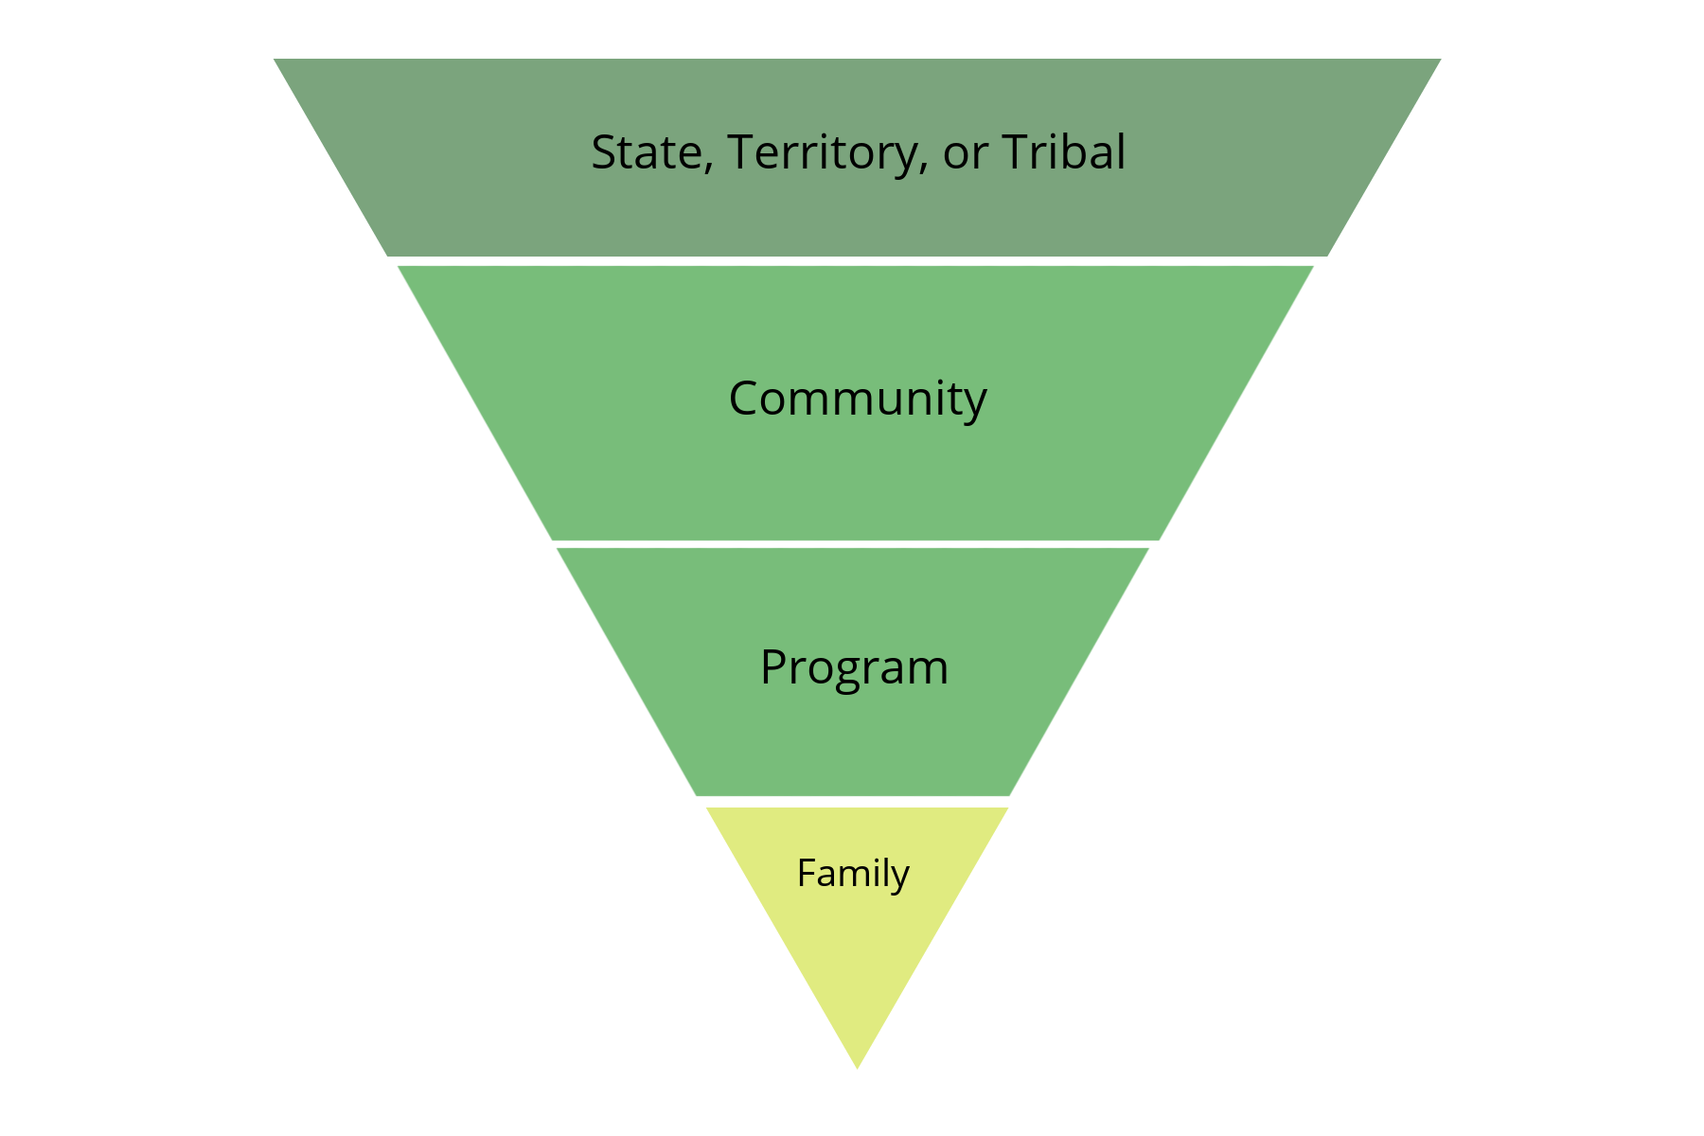
RE-Defining Outreach
Notes:
10. Slide Time: 1min / Total Time 14 min
Say: And as we flip the narrative, we move from a flow of information that is trying to make its way upstream, to a model where we are pouring into our families and communities. In this model, every service, project, program or resource that we develop to meet our mission MUST include a plan for getting it out to the people we want to have it. So, lets look at that definition again.

Slide 11
RE-Defining Outreach
Outreach is a data-driven and strategic communications initiative that is culturally responsive and increases the knowledge or awareness of specific services, supports or practices in a specified community.
Notes:
11. Slide Time: 3 min / Total Time 17 min
Say: So here is our big, fancy, formal, new outreach definition. Outreach is a data driven and strategic communications initiative, that is culturally responsive and increases the knowledge or awareness of specific services, supports or practices in a specified community. I’m going to pause for a second so that we can process that, because it is a lot.
Do: Wait for about 20 – 30 seconds
Say: Does anyone have a reaction to this?
Do: Take answers and prompt discussion.
Say: The bottom line is this. Posting to social media, putting up flyers in the community, sharing events on local calendars and those types of activities may be part of your plan, but the key to successful outreach lies in the beginning of our definition, it is data driven and it is strategic.

Slide 12
Passive Outreach vs. Active Outreach
Passive Outreach
Active Outreach
We have something to offer, and people who want or need it will come to get it.
I have posted the information on all our channels; now we’ll see how much engagement we get.
We have something to offer, and we need to get it out to people who need or want it.
I have posted the information on all our channels. How can I make sure it gets in front of those who I want to see it?
Notes:
12. Slide Time: 1 min / Total Time 18 min
Say: There are two primary approaches to outreach – passive and active. Passive outreach is a valid part of any strategic outreach plan, but passive outreach will rarely get our services and resources to all of the families who need them. I used to hear this referred to as the "low hanging fruit" plan. In other words, these are people who really easy to reach and may just drop right out of the tree and into your program just because you happened to be standing nearby. This type of outreach comes from a place of "We have something to offer, and people who want or need it will come to us to get it" and also, "I have posted the information on all our channels, now we'll see how much engagement we get." I have talked to social media managers who truly believe that as long as they post things once a day, they have done all they can do, and I have talked to family and community engagement professionals who go to a booth, put a bunch of stuff on a table and think that’s all they can do. In all of our outreach efforts, we have to be thinking of that inverted pyramid. We have something to offer and we need to get it out to people who need or want it. This is active outreach. It is flipping the script from "that's all I can to" to "how can I get this in front of those who I want to see it?"

Slide 13
Cycle of Outreach
Notes:
13. Slide Time: 1 min / Total Time 19 min
Say: Now, let's talk about how to get from passive outreach to active outreach, by building a strategic outreach plan. To do this, we need to understand the cycle of outreach.

Slide 14
Cycle of Outreach
Notes:
14. Slide Time: 1 min / Total Time 20 min
Say: Active outreach is not linear, because there is no start and stop to this work. When you are jumping into the cycle, you would start with a needs assessment. From there, you will identify your end goal, develop a strategy to meet that goal, build partnerships to help execute the strategy, then craft the message and finally measure your impact.

Slide 15
Conduct a Needs Assessment
What resources exist?
What resources are needed?
Where do people go for information?
What communities are most in need of our services or information? Where do members of these communities congregate?
Think of physical and virtual spaces
Notes:
15. Slide Time: 1 min / Total Time 21 min
Say: We have another webinar where we talk extensively about conducting needs assessments, but for this purpose there are just a few things to think about, in the context of outreach. What resources already exist? What resources are needed? Where do people go for information? What communities are most in need of our services or information? Where do members of these communities congregate? And a little note here, think of both physical and virtual spaces. There are lots of opportunities to get in front of families, but you do have to look for them a bit and be willing to meet people where they are.

Slide 16
Identify the End Goal
What issue are you trying to address?
How will you know if you have been successful?
Who does this matter to?
Notes:
16. Slide Time: 1 min / Total Time 22 min
Say: As with many things, it is important to start with the end in mind. What is the issue you are trying to address. Be specific and name it out. How will you know if you have been successful? What does that look like to you and your stakeholders? And, who does this matter to? Who are the people I need to reach to be successful. And remember that the A in smart goals is achievable. Make sure that when you set goals, they are in your power to achieve.

Slide 17
Develop a Strategy
Using your measures of success, work backwards.
How will you make sure that the people you want to reach have gotten your message in a way that is meaningful, clear and culturally responsive?
Notes:
17. Slide Time: 1 min / Total Time 23 min
Say: Once you have your goal in mind, work backwards. Think about how you will make sure that the people you want to reach get your message in a way that is meaningful to them, clear and culturally responsive. We work with a large population of Haitian-Creole families in my state. If I am producing materials only in Spanish and English, I can't be upset when we don't have a large response from Haitian-Creole families. I also can't be upset if I haven't made my outreach meaningful. Handing out flyers at a community festival is great, but you know what is better? Partnering with a community champion to come to your booth at the community festival and help engage with the families they know. Actual conversations. You can put all the branded items on your table you want, but the meaningful conversations will give you a much better return on investment, and that is free. In fact, whenever I go to a community event or festival, I spend a chunk of time walking around to other booths and talking with their staff to find areas where we can work together to reach more people and build understanding.

Slide 18
Build Partnerships
Who are the stakeholders involved?
Go back to the needs assessment to identify potential opportunities for coalition building.
Who is working towards the same goals and how can we share the effort required?
Notes:
18. Slide Time: 1 min / Total Time 24 min
Say: Which brings me to – Build partnerships. Who are the stakeholders involved? From the needs assessment, where are the opportunities for coalition? Who is working towards the same goals and how can we share the effort required? If we are working towards the same goal, there is no reason to treat other community partners like the enemy. The more people working towards the same goal, the better.

Slide 19
Build Partnerships
Notes:
19. Slide Time: 1 min / Total Time 25 min
Say: Remember this image. Which of these boats is more likely to reach the finish line first?

Slide 20
Craft the Message
A well-crafted message is:
Clear Related to the goal
Consistent Memorable
Inspiring Relatable
Culturally responsive Not a pitch
Notes:
20. Slide Time: 1 min / Total Time 26 min
Say: When its time to craft the message, it is important to make sure that the message is:
Clear
Consistent
Inspiring
Culturally Responsive
Related to the Goal
Memorable
Relatable and
Not a Sales Pitch.
This is one of the many reasons that it is important to engage stakeholders and partners throughout the outreach cycle. Something isn't necessarily clear, just because it is clear to you. If you have said the same words to the same audience the same way multiple times and never gotten the outcome you want, the problem isn’t the audience. The same goes for being culturally responsive. Building messaging that is culturally responsive means taking feedback from a wide range of people who represent various groups in your community and acting on that feedback. It is the acting on it and using culturally responsive messaging that will build trust within your audience, and at the end of the day an audience that trusts you is more likely to engage. Of course, making sure that your messaging is related to your goal is important. Finally, remember, you are not selling used cars here. This is not a sales pitch. People can sense a pitch from a mile away, and while they might engage with your services because it sounds like something they need, they won't necessarily feel like they can trust your organization. When people hear a sales pitch, their immediate response is usually "what's in it for you?"

Slide 21
Craft the Message
Take time to identify the purpose of the message and why it is important.
Highlight what can be achieved by engaging.
Make sure to include a call to action.
Notes:
21. Slide Time: 1 min / Total Time 27 min
Say: As you are crafting your message, take time to make sure you have a clear purpose and that you understand why that message is important. If you don't understand its importance, you can't expect everyone else to. Double and triple check that you have highlighted in your messaging what the audience can achieve by engaging. Coming to our Facebook Live series on Medicaid Redetermination will help you make sure you don't lose coverage. And finally, always include a call to action. Now that I have given you this information or shared this resource, here's what I want you to do with it. I want you to call us, I want you to register for our webinar, I want you to fill out this survey, etc.

Slide 22
Measure Your Impact
Did we reach our vision of success?
If yes, what was successful?
If no, what went wrong?
What have we learned and how will that impact our efforts moving forward?
Notes:
22. Slide Time: 1 min / Total Time 28 min
Say: And, once you have crafted the message, prepare to measure your impact. You already identified your vision of success, now it's time to look at the results of your messaging and figure out if you were successful, or not. Either way, come back to the team and talk through what happened. If you were successful, great, what worked? If not, what went wrong? What didn't you anticipate? Where did you miss the mark? And, what have we learned and how will that impact our efforts moving forward. Once you have those answers, you can start the cycle over again and work on your next goal.

Slide 23
Cycle of Outreach
Notes:
23. Slide Time: 1 min / Total Time 29 min
Say: Understanding outreach as a cycle instead of an activity, helps to put the focus where it needs to be, on continuous improvement. As we work through the steps, we can identify gaps in communications clearly and keep getting better at how we are reaching out to families. It also helps to clearly show why it isn't enough for one person on a team to be responsible for outreach.

Slide 24
Creating a Culture of Outreach
Notes:
24. Slide Time: 1 min / Total Time 30 min
Say: For outreach to be effective, we must create a culture of outreach around us and within our organization.
Poll: What percentage of staff in your organization are an active part of your outreach strategy?
Say: The goal should always be for 100% of the team to be involved in outreach. We all have a role to play in making sure that our messages get to those who we want to see them. That role may be crafting the message, or it might simply be sharing, reposting or interacting with content and messaging.

Slide 25
A Culture of Active Outreach
Organizational commitment to active outreach
Data-driven strategies
Involves stakeholders, including families, throughout the process
Resources and funding committed to outreach
No wrong door
Collaborative approach - "All Hands On Deck"
Notes:
25. Slide Time: 2 min / Total Time 32 min
Say: If we want to get the most return on our outreach efforts, we must build a culture of outreach within our organizations, and I will even go a step further to say that we need to build a culture of ACTIVE outreach. Building a culture of active outreach means that everyone in our organization buys into the importance of active outreach and they share in the creation and implementation of data-driven strategies. A culture of active outreach also means that stakeholders, including families, are engaged throughout the process and that resources and funding are committed to outreach. I knew an organization that spent millions on training their teams across the country to be more active in engaging with their target audiences, but then had zero money in the state budgets for the teams to implement the strategies. There must be a commitment at all levels, to reaching the people who most need your services and resources.
The next item on this list is "No Wrong Door," which was one of those "buzz" phrases a few years ago. Basically, this means that it doesn't matter who in your organization a person talks to, they will get what they need. There is absolutely nothing more frustrating than the runaround. We can't just each work in a silo and expect people who need our services to read our minds and know who they need to talk to, or the names of our programs. They have to be able to talk to someone, every time they open a door, who makes them feel valued and helps them get what they need – whether that is our job or not. A collaborative approach means everyone on the team knowing what your programs are, and ACTIVELY helping to reach your target audiences. It's making sure that your partners know everything that is available from your organization, and ACTIVELY helping you reach your target audiences. It's taking the responsibility of awareness off the people who need your services and placing it in house. When it comes to outreach, it really has to be "All Hands On Deck." Now let's look at how you get that culture of active outreach buy in.
USE A PERSONAL EXAMPLE OF A TIME YOU ENCOUNTERED A “WRONG DOOR” TO MAKE THE POINT

Slide 26
Getting Buy In
Build a shared understanding of active outreach and a commitment from all staff to be a part of this work.
Notes:
26. Slide Time: 1 min / Total Time 33 min
Say: To start off, you have to build a shared understanding of that outreach re-definition we looked at earlier as well as the difference between active outreach and passive outreach. Once everyone is on the same page for what active outreach means, then there has to be a commitment from the entire team, that they will be a part of this work. This can be a tough sell to some people, and the analogy I like to use is a boat. Specifically a row boat. When you look at these two pictures, which boat is going to get to the other side of the lake faster? We all have to be pulling in the same direction, at the same time. When we say "All hands on Deck!" Or "We're all in the same boat." We mean it fairly literally.

Slide 27
Getting Buy In
Work with community partners and stakeholders to find champions for the work you are doing.
Notes:
27. Slide Time: 1 min / Total Time 34 min
Say: Once your team is "on board" (pun intended), the next step is to build out your network of community partners and stakeholders so that you can find champions for the work that you are doing. There are other organizations out there who are working with the same populations of people you are trying to reach. Early in my career, I was working for an organization that had amazing brand recognition. In fact, they have such strong brand recognition that globally, they rank 2nd behind Coca-Cola as the most recognized brands in the world. People knew who we were. What people didn't, and in a lot of cases still don't know is all that that organization does. Our divisional leadership was challenging us to get out and build service awareness and he asked us if we knew why Tupperware was such a successful brand. They found champions. Other MLMs too. Now, I am not telling you to go out and invest in an MLM as a side hustle, but what I am saying is that the models they use work. Remember when we looked at the pyramid and we talked about family outreach? Family outreach is successful. When one family tells another family about a resource or an event, they are more likely to participate or attend. The challenge then is finding those "champion" families and champion organizations that will help you reach their networks. This is going to look different in every community, but the only way to find those families and partner organizations is to use our networks and go searching. Facebook groups, "next door" posts, schools, PTA/PTOs, youth sports organizations, habitat for humanity, food banks, churches, social clubs. Your champions are out there.

Slide 28
Getting Buy In
Build outreach into all planning, including budget and staffing allocations.
Notes:
28. Slide Time: 1 min / Total Time 35 min
Say: Another important part of getting buy in, is to make sure that outreach is a part of all planning, including budget and staffing allocations. We can offer all the services in the world, but unless we can get those services to the people who need them, we aren't going to meet our goals. When we start talking about the budget, outreach has to be a part of that. Ditto for strategic planning processes and staffing plans. Outreach has to be the foundation of everything we do.

Slide 29
Getting Buy In
Focus on consistency and sustainability.
Notes:
29. Slide Time: 1 min / Total Time 36 min
Say: As you are planning and strategizing, focus on sustainability and consistency. Especially when we talk about social media outreach strategies, consistency matters, big time. If you are posting here and there without any kind of consistency, you will not build followers. I once worked with a team and their entire goal was to get one post to go viral. That was it. They figured that it didn't matter if every post got views, they just needed one to go viral and they would be set. You can guess how well that worked. Their entire page was just one crazy post after another, that weren't really reaching their desired audience or promoting their services. Tortoise and the hare story comes to mind. Going viral is wonderful, but you have to build a foundation that will hold up to that level of attention or else that one viral post would be all you ever have. You want people to follow you, and they will do that because you consistently post things that are useful, interesting, or validating to them. Consistency is also key to getting the internal buy in you need because your team needs to know what you are doing and how you are doing it, and they have to have confidence that if they participate, if they start inviting their personal connections, that the content and the information will be consistent. The reason I have the word sustainability here, is because to reach consistency, your plans have to be sustainable. Several years ago I was doing a campaign for an organization during their specific awareness month. The plan was to do a "takeover" every day in the month of April. Now, if you don't know, a takeover is when you post only content from a partner for an entire period of time, usually a day. So in one month, there would be 30 different organizations submitting posts, up to five per day. The logistics of this were an absolute nightmare. It was wildly popular and now they do it every year, but, if they had tried to do this all the time they would have burned out and likely there would have been less and less effort going into it over time. The audience probably would have gotten bored too. If you start something that you promote as a series, you have to be prepared to carry that series out for a specified length of time. If you aren't able to keep up, your audience will see that and lose confidence in your ability to follow through. So, as you are planning, make sure that your plans are sustainable.

Slide 30
Getting Buy In
Age is not necessarily correlated to social media comfort or skill levels.
Notes:
30. Slide Time: 1 min / Total Time 37 min
Say: This is always such an interesting topic to bring up. Age is not necessarily correlated to social media comfort or skill levels. I'll use a personal story here too. My middle child has worked in the non-profit sector for years and everyone always assumes that because they are a teenager, they know social media. They think Facebook and Twitter (or X its now called) are far too complicated, but they do use TikTok and Snapchat and Instagram regularly. So one day, she was doing an internship with a local non-profit and the manager handed them a stack of papers and asked them to create social media content. They had no idea what they were doing, or where to start. At one of my previous orgs, we were looking for volunteers to help with social media outreach and I kid you not, in the meeting to talk over the need, the manager said not to interview anyone over 23 because they wouldn't know what they were doing. Now the target audience for that organization was parents, but they wanted their outreach done by someone in college or freshly graduated. I am no expert on TikTok or Snapchat, or Instagram or Telegram or any of those apps, but if you need to get information to middle aged parents, I'm your girl. If you are trying to reach teenagers and college students, absolutely get the perspective of someone who is a teenager or college kid. The key here is not assuming that just because someone is over 40 doesn't meant they aren’t comfortable with social media and just because someone is under 30 doesn’t mean that they are.

Slide 31
Getting Buy In
Make sure policies and procedures align with the goals you have set.
Notes:
31. Slide Time: 1 min / Total Time 38 min
Say: Finally, make sure that your policies and procedures align with the goals you have set. In all my years of working with organizations to build out their communications and outreach, I have seen some stuff, and this particular slide is so important to getting buy in from your organization. If your team keeps butting their heads up against a brick wall, you'll lose their buy in. For example, one of the organizations I worked with had blocked all access to social media from their company computers. For everyone. Including the communications director. No one could access any sites from their work computers, and when they challenged this, they were told that organization policy was to block social media so that there weren't distractions on company time. Well, how do you get buy in from a team when you ask them to like, share, follow and promote your content but they aren't allowed to do it from work? It also needs to be very clear how to share content and the procedure for submitting any content you might have. Clear, defined procedures along with clear, defined parameters AND a shared understanding of your communications strategy will help you to get buy in. If I keep submitting articles that I think are important to share on social media and they never get posted, but no one tells me why, what am I going to do? I am going to stop sending them. Make sure to align the way your organization works with the goals you have set so that everyone can be a part of reaching the goals.

Slide 32
What's Working?
A story or an example of a time that you saw an outreach strategy make a difference in an outcome?
What is working for your team?
What has worked for other teams you have worked with?
Has anyone had a social media post go viral?
Do we have anyone here with a large TikTok following?
What low- or no-tech strategies have you found effective?
Notes:
32. Slide Time: 10 min / Total Time 48 min
Say: Here's where we are going to put you to work today. We have shared lots of stories, but now we want to hear some of yours. So, what's working? I know we tend to have quiet calls, but let's break that habit. Can anyone share a story or an example of a time that you saw an outreach strategy make a difference in an outcome? What is working for your team? What has worked for other teams you have worked for? Has anyone had a social media post go viral? Do we have anyone here with a large TikTok following? What low or no tech strategies have you used?
Do: Facilitate Discussion

Slide 33
Review
Learn the distinction between passive and active outreach.
Understand the six parts of the outreach cycle and how to use this model to increase community impact.
Describe effective strategies for building a culture of outreach within an organization.
Notes:
33. Slide Time: 1 min / Total Time 49 min
Say: In our time today, we have learned the distinction between passive and active outreach, looked at the six parts of the outreach cycle and learned how to use the cycle to increase our impact in the community. Finally, we looked at effective strategies for building a culture of outreach within an organization.

Slide 34
Sticky Notes
What is ONE thing I heard today that is important enough to go on a sticky note?
Notes:
34. Slide Time: 5 min / Total Time 54 min
Say: I wanted to finish up today with a little activity. One thing you might not know about me is that I LOVE sticky notes. I use them for everything. Years ago I was at a conference and a presenter finished their session by handing out sticky notes and asking us to respond to the question I have here. What is ONE thing I heard today, that is important enough to go on a sticky note and live on your desk or wherever you work. I love the activity and so I tend to use it a lot. I haven't don’t it with this series yet, but today felt like a good day to change that. So, if you have sticky notes handy, I invite you to write your answer on a sticky note. If not, you can use your digital sticky notes, or any little piece of paper, an open word document, wherever you want to put it. I'll give us all a minute or two and then if anyone wants to share their answer, you can raise your virtual hand.
Do: Wait one – two minutes and then solicit answers.

Slide 35
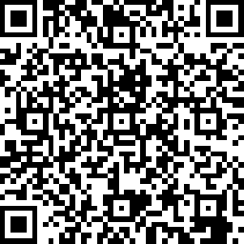
Post-Session Questions
https://www.surveymonkey.com/r/StayCoveredMod5Post
Notes:
35. Slide Time: 2 min / Total Time 56 min
Say: We’ll wrap up now by taking a few minutes for our post-session questions. If you would, please, use the QR code above or the link in the chat to complete the post-session questions.
Share in Chat: https://www.surveymonkey.com/r/StayCoveredMod5Post

Slide 36
Update with your Contact Information
Update with your Contact Information
Notes:
36. Slide Time: 4 min / Total Time 60 min
Now, we’d like to open the floor up for discussion and questions. If you have a question, or a comment, or would like to share something that has worked for you, raise your hand or drop a note in the chat.

