Slide 1
The Family Engagement in Systems
Assessment Tools
Promoting Meaningful Family Engagement in Systems Change
www.familyvoices.org

Slide 2
Family Engagement in Systems Tools

Slide 3
Family Engagement in Systems Assessment Tools (FESAT)
Families and staff can use the FESAT to learn if all participants have the information and supports they need to participate, partner, and contribute to decision-making groups.
Compare perspectives on how family engagement is going.
Identify what is working well.
Identify areas for improvement.
Child- and family-serving organizations can use the Checklist in the Family Engagement in Systems (FES) Toolkit to establish family engagement processes.
Identify supports already in place to ensure meaningful family engagement.
Explore strategies and resources for additional ways to encourage and support family engagement.
Families and staff can use the FESAT and FES Toolkit to track progress in family engagement efforts.
Complete the FESAT and use the results as a baseline score.
Identify an area for improvement and select a strategy from the FES Toolkit that can help.
Complete the FESAT again at scheduled intervals and compare results to the baseline.
Request the FESAT (https://familyvoices.org/fesat/)
For questions or technical assistance, email Beth Dworetzky (bdworetzky@familyvoices.org)

Slide 4
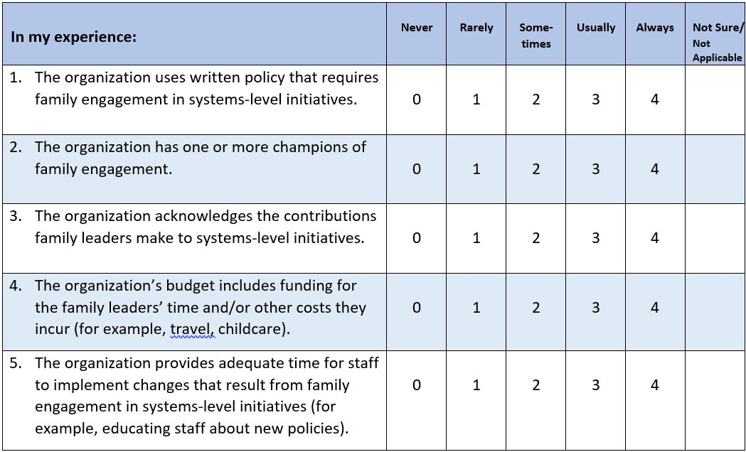
Domain 1: Commitment means that the organization routinely engages family leaders in all systems-level initiatives that affect the policies and programs that govern services for children, youth, and families.

Slide 5
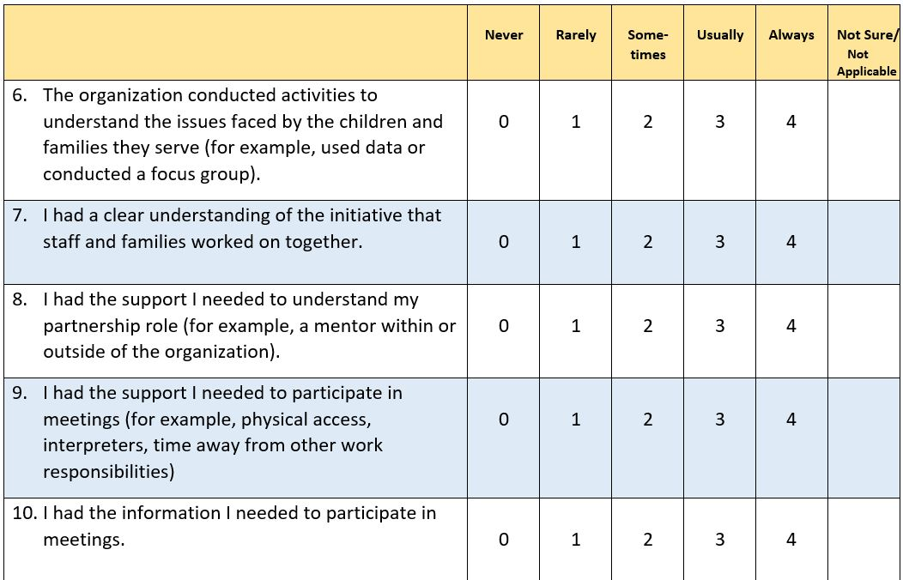
Domain 2: Transparency occurs when the organization clearly documents and communicates about how it Identifies issues faced by the children and families they serve; provides the information and supports family leaders need to participate to their maximum potential in the systems-level initiative.

Slide 6
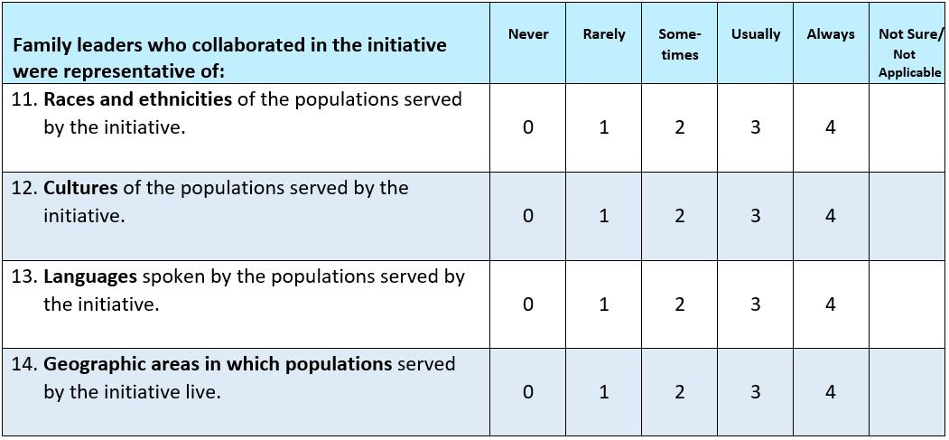
Domain 3: Representation occurs when family leaders reflect the diversity of the community served by the policy, program, practices, and services provided by the organization.

Slide 7
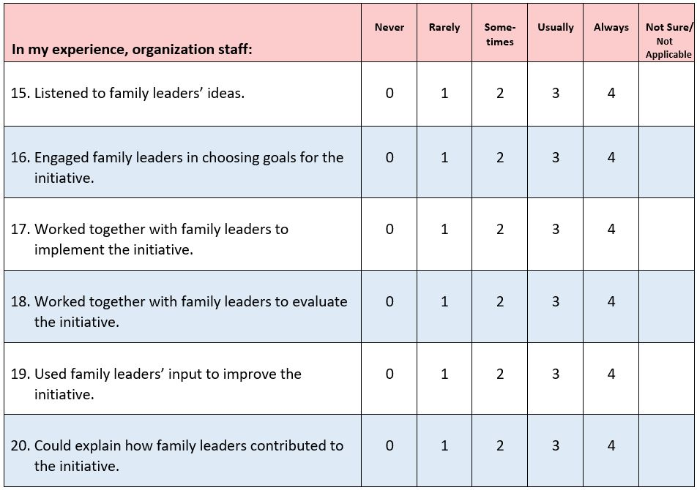
Domain 4: Impact describes the areas where family leaders’ ideas were incorporated at the systems level to improve policies, programs, services, and practices.

Slide 8
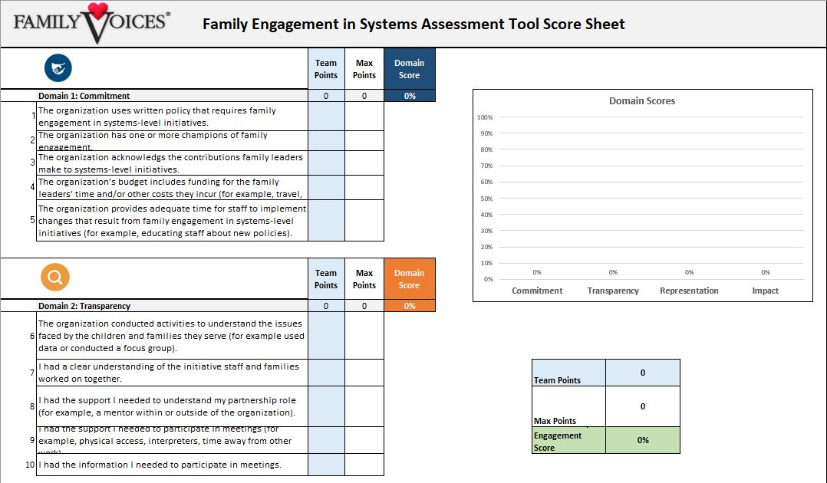
FESAT Score Sheet

Slide 9
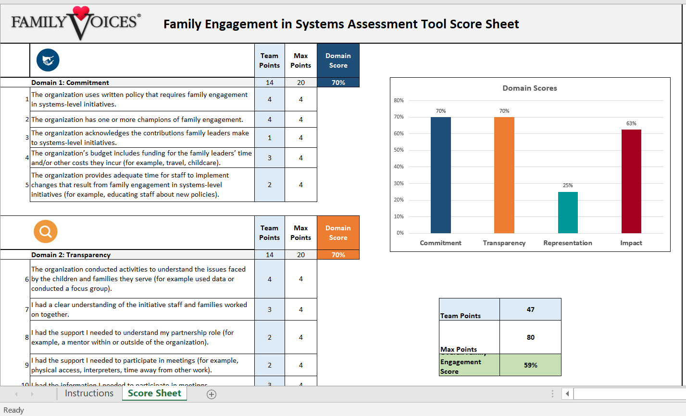
FESAT Score Sheet

Slide 10
Family & Staff Scores
Family Partner Scores
Staff Scores

Slide 11
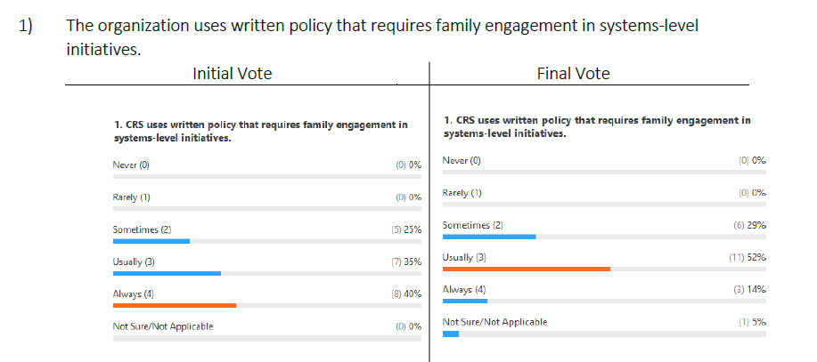
Consensus Discussion

Slide 12
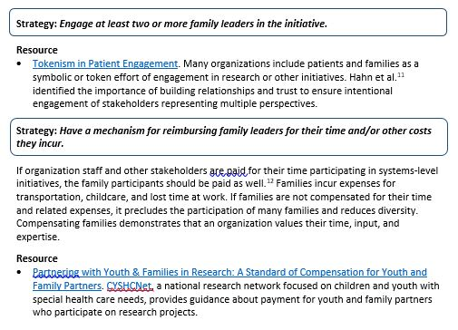
FES Toolkit: Commitment

Slide 13
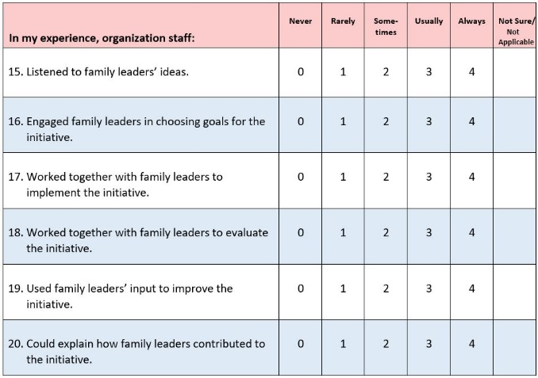
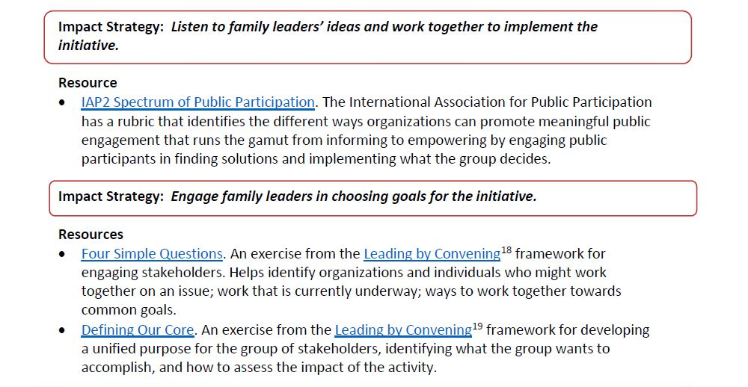
Impact Strategy & Resource

Slide 14
Learn More
Explore the items in the 4 Domains of Family Engagement
Download the Family Engagement in Systems Assessment Tools
Request TA

Slide 15
Thank You

