Slide 1
Starting and Maintaining Youth Advisory Boards
In partnership with
Notes:
Will –technology information
Dawn - welcome
Thank you for joining us today! This is the third of a three part webinar series on Starting and Maintaining Youth Advisory Boards. This series is produced by KASA, Kids as Self Advocates in partnership with The SPAN Parent Advocacy Network, REACH for Transition, Vermont Family Network, the Peal Center, Family Voices and the National Center for Family Professional Partnerships.
We want to give a special thanks to NANFI LUBOGO, Co-Executive Director of PATH, Parent to Parent & Family Voices of Connecticut and Dawn Monaco, Senior Parent Professional Trainer Coordinator and Co-Director of REACH for Transition at SPAN.

Slide 2
a national, grassroots project of Family Voices created by youth with disabilities for youth.
Notes:
Dawn
KASA is a national grassroots project of Family Voices created by youth with disabilities for youth.
Hamza
We believe youth can make choices and advocate for themselves if they have the information and support they need. We believe this because we live this! We are leaders in our communities, and we help spread helpful, positive information among our peers to increase knowledge around various issues. We also help health care professionals, policymakers and other adults in our communities understand what it is like to live our lives and we participate in discussions about how to help each other succeed.
We create tools like this webinar to share Information for youth by youth in such areas as: Civil Rights and Advocacy, Education, Health, Work, Sports and Leisure, Dating and Relationships, and more.

Slide 3
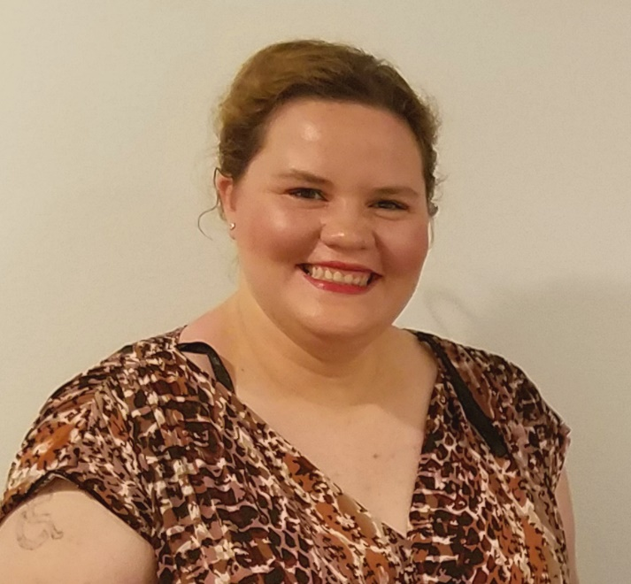
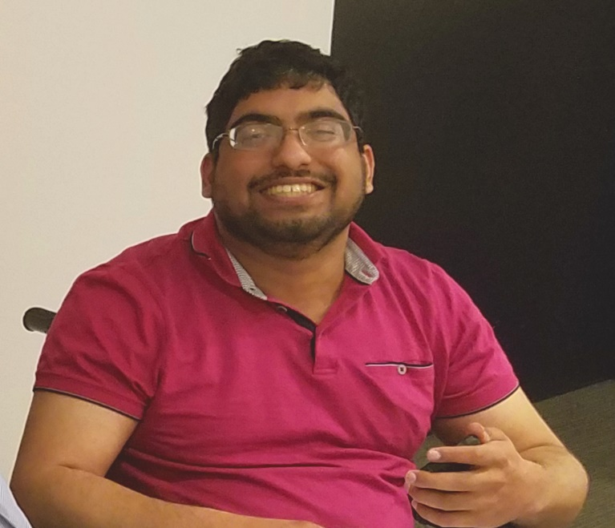
Presenters
Emily Robinson
Hamza Jaka
Notes:
Dawn
Emily & Hamza, be sure to give a little of your background as a KASA member and a self-advocate.

Slide 4
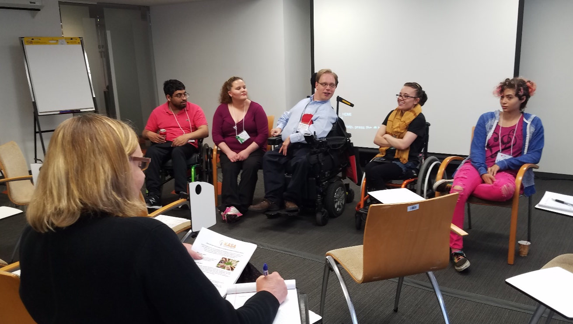
Part 3: Creating a Foundation for Success
Notes:
Emily
This is the third of three webinars about starting and maintaining an youth advisory board. In this webinar we are talking about the third and final step…Creating a Foundation for Success
This webinar focuses on
The nuts and bolts of establishing a board
Effective ways to keep it going
Suggestions to engage aged-out youth

Slide 5
What We Learned
Building Youth as Self-Advocates
Notes:
Hamza
In our second webinar, we talked about building youth self-advocates into leaders. We talked about what a self-advocate looks like, and outlined a number of leadership skills a self-advocate needs to lead a project or a meeting. We also talked about the types of trainings youth need to build their leadership expertise.
No need to verbally acknowledge this…
NOTE: Some of the photos used in this presentation came from:
Youth Ability Summit
http://worldenabled.org/our-work/youth-ability/
Mobility International USA
https://www.miusa.org/
My AFK (in London) Join Our Council photo, Analie, residential banner, residential1, diverse-workforce, pops-3
https://www.my-afk.org/how-we-help/advocacy/

Slide 6
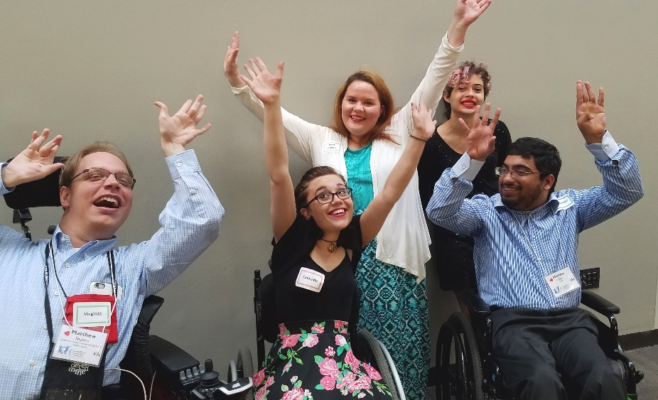
Today we will explore…
How to establish a youth board.
How to sustain it.
How to keep youth engaged after they age out of service.
Notes:
Emily
Today we will explore:
How to establish a youth board.
How to sustain it.
How to keep youth engaged after they age out of service.

Slide 7
Establishing Youth Boards
Notes:
Hamza
There are a lot of things that need to be in place when you establish a youth board. We are going to share some of the most important elements we’ve used with KASA over the years.

Slide 8
Establish a Mission & Vision
KASA Mission Statement
Kids As Self Advocates (KASA) is created by and for youth with disabilities to educate society about issues concerning us. KASA believes in self-determination, creating support networks and self-advocacy for all youth with disabilities in our society.
Notes:
Emily
It’s really important to have a clearly articulated mission and vision for your youth board. As with any organization, the mission becomes the glue that holds it all together. This is KASA’s mission statement – (READ IT).
As you can see, it is simple and yet filled with all the details to explain who we are and what we stand for. Our mission keeps us on track…We make sure that all of our work is aligned with our mission.

Slide 9
Establish a Mission & Vision
KASA’s Theory of Change
By informing youth about their rights, providing peer support and training, and changing systems to include us, we believe that young people with disabilities will have control over their own lives and futures.
Notes:
Hamza
KASA also operates under what we call our “Theory of Change”. It’s a nontraditional vision statement that drives our mission. READ IT

Slide 10
Establish a Mission & Vision
KASA’s Values
• We educate others about our issues.
• We provide and expect equal opportunities.
• We focus on disability pride, culture and current issues.
• We promote independence and interdependence.
• We give and expect respect.
• We believe in self-advocacy for youth and young adults with disabilities.
• We believe in self-determination.
• We believe youth organizations, projects and activities should be youth-run.
Notes:
Emily
These values guide our day-to-day interactions with each other, with the KASA network and members of our community. READ IT

Slide 11
Create Guidelines
Notes:
Hamza
Building a structure around your activities is really important to do from the get go. Everyone needs to be on the same page as they work together and they need to understand the rules to effectively participate. They don’t need to be complicated, they just need to exist and be followed.

Slide 12
Establish agreements, plans & agendas
Notes:
Emily
Another important part of the infrastructure of a youth board includes establishing board member agreements, annual and monthly strategic plans with objective-driven meeting agendas.
KASA has a standard board member agreement that every new member signs prior to attending their first meeting. It outlines what is expected of every board member in terms of acceptable participation. It explains the member’s responsibilities and provides information about what to do if he/she cannot make a meeting.
KASA also has a strategic plan. We just updated it during the recent Family Voices Family Leadership Conference in Washington, DC. We will be using it as our guide for the next three years. It has goals, action steps and activities that will be assigned to committees and board members, then tracked over time until they are completed. It is our framework designed to move us forward and grow.

Slide 13
Establish partnerships
Notes:
Hamza
A youth board is a true investment for any organization. A board works best when supported by adult allies and partnering organizations. KASA has been a project of Family Voices for a number of years. Our experience has shown us that we thrive with the right combination of funding and staff support. With out it we struggle. So when you are setting up your youth board, be sure to make a firm commitment of time and money to ensure it’s viability.

Slide 14
Organize Meetings
Notes:
Emily
The next thing that is critical to establish is a regular meeting time and place. Some of you may be fortunate enough to have your members live nearby, so hosting an in-person meeting is easy to do. KASA isn’t so fortunate, but we are very grateful for technology! Our members live all over the country and cross 4 time zones. Many of us are students or are working.
To accommodate everyone, we now have our board meetings on a Saturday and we use video conferencing with Zoom. So even though we aren’t physically together, we can see each other and connect on a deeper level. We also make sure all of our meeting materials are accessible, meaning they can be read by screen readers. And we provide captioning during our Zoom meetings.
If your meetings are held in person, be sure the meeting space is accessible for all the members and you provide any accommodations necessary for their participation. Ask your members ahead of time how you can best support them.

Slide 15
Sustaining Youth Boards
Recruit new members
Develop new member orientation
Create a succession plan
Notes:
Hamza
Once you have established your youth board, you need to be sure it can sustain itself over time. We talked about this a little already, but it is worth bringing up again in a different context. The board needs to actively recruit new members ongoing. Boards often set term limits for members and age limitations. That way the board can grow new youth leaders as others rotate off the board.
As new members join, it is really important to provide an orientation for them. KASA provides all of it’s new members with a packet that includes a welcome letter from the board chair, our Mission, Theory of Change and Values statement, an organizational chart of Family Voices, and the board member agreement.
Another aspect of board membership is succession planning. Succession planning is a process for identifying and developing new leaders who can replace old leaders when they leave. A succession plan helps identify the key roles in a board and the members best suited to fill those roles in the future. It is often part of a strategic plan. KASA’s new strategic plan includes elements of a succession plan. We have a couple of veteran members who will be rotating off the board soon and we are identifying younger members who can take on their leadership roles when they leave.

Slide 16
Sustaining Youth Boards
Develop a strategic plan
Establish & maintain website and social media
Create a buddy/check in system
Notes:
Emily
Strategic planning is important to a board because it provides a sense of direction and outlines measurable goals. It’s a tool that is useful for guiding day-to-day decisions and also for evaluating progress and changing approaches when moving forward. As we mentioned earlier, KASA just updated it’s strategic plan last month. It is giving us a clear outline to move forward.
Another way to help sustain a youth board is by establishing and maintaining a strong online presence. Information about the board needs to be readily available to the public and sharable. A website and social media are a must.
And finally, having some sort of buddy or mentoring system in place really helps members feel supported and guided.

Slide 17
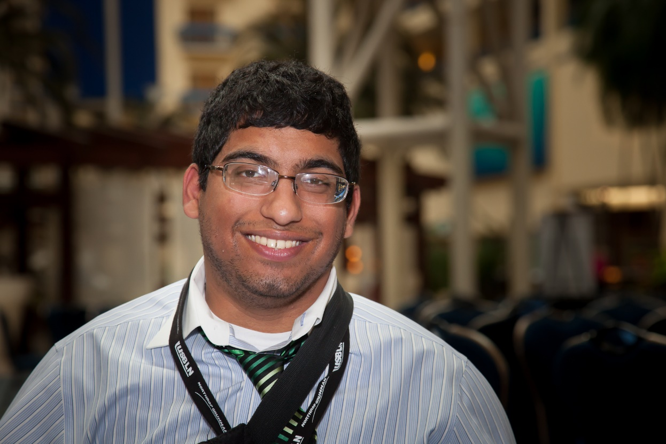
Hamza’s Story
Notes:
Hamza
I appreciated the buddy system that KASA had. It allowed me to connect with people that later became great mentors, like Micah Fialka Feldman, maintain regular involvement with the board and it made it easier to connect and work off of each other in our person meetings. Because of our semi-regular phone calls, it made it really easy to connect with Micah when I worked with him. With regard to establishing strategic plans, I would encourage young people to facilitate the meeting as much as possible. Allow youth to set goals, even if bigger than we think and encourage youth by setting up benchmarks to get there. If we are supported, we can do it.

Slide 18
Engaging Aged-Out Youth
Create new roles
Develop an alumni association & email list
Invite alumni to meetings, trainings and retreats
Notes:
Emily
As youth age out of their positions as board members, we encourage you to find new roles for them to help support the board. These could include becoming paid consultants or volunteer advisors. The important thing is to keep them engaged in meaningful ways so they can share their wisdom without the time commitment of being a board member.
Start an alumni association & email list and send out updates from time to time. Share all the great things the board is doing and offer suggestions for them to stay involved. Also stay connected to them through social media. Sometimes that’s the quickest way to share timely information.
Invite them to special meetings, presentations, training events and retreats. Just be sure to have something specific for them to do so they feel they are making a contribution.
And THANK THEM! A little appreciate goes a long way.

Slide 19
Engaging Aged-Out Youth
Consult alumni about organizational changes
Ask for suggestions for new members
Share their experiences with current members
Notes:
Hamza
Another way your alumni can support your board is to consult them about any big changes you are considering. KASA enlisted the help of a former member recently when we were overhauling our website. It was really helpful to hear her perspective. She shared some history that we didn’t know about and offered her support in the future if we needed it.
Alumni can also help identify new members, and can provide mentoring to the board. They could also provide training, and be a great source to connect to their networks.
The expertise and wisdom of former board members is something you really don’t want to lose. Sharing their knowledge enhances the development of all board members. Last month when 5 members of the KASA board were able to meet in Washington at the Family Voices conference, we got to meet a former director of our board and have dinner with her. We learned so much from that visit!

Slide 20
Emily’s Story
Notes:
Story about West Virginia Statewide Independent Living Council youth board.
The youth board has a say in every event
Youth input on every event & project
SILC retreat to revamp mission & values to include youth
A whole page on website for youth
Newsletter has a youth column
We follow youth where they hang out around town to recruit them
A flyer with her personal cell phone rather than just a website url

Slide 21
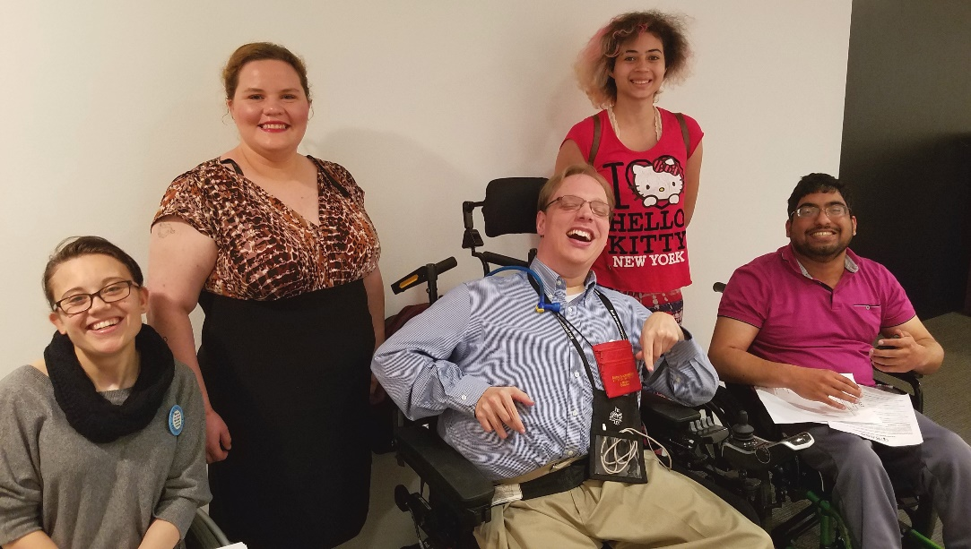
Thank You!
Emily Robinson: erobinson2@wvstateu.edu
Hamza Jaka: hamzajaka@gmail.com
Notes:
Both Emily & Hamza
Thank you so much! ( Do a brief summary of the webinar series and let them know they can reach out if they need any help as they develop their board.)

Slide 22
Q & A
Before you go! Please click here to complete a brief feedback survey so that we can continue to improve our offerings to you! Thank you.
Notes:
Thank you! We have a few minutes now for questions and comments.

Slide 23
CONTACT US
Kids as Self Advocates
fvkasa.org
Family Voices
familyvoices.org
National Center for Family & Professional Partnerships
familyvoices.org/ncfpp
SPAN Parent Advocacy Network
spanadvocacy.org
REACH
spanadvocacy.org/content/reach-transition-resources-employment-access-community-living-and-hope
PEAL Center
pealcenter.org
Vermont Family Network
vermontfamilynetwork.org

