Slide 1
Title V Block Grant Maternal & Child Health
National Center for Family-Professional Partnerships @
National Family Voices
3701 San Mateo Blvd., NE Suite 102
Albuquerque, New Mexico, 87110 866-835-5669
“Keeping families at the center of children’s healthcare”

Slide 2
Presented by Diana Autin, Executive Co-Director, SPAN Co-Director, National Center for Family-Professional Partnerships Director, National Center for Parent Leadership, Advocacy, & Community Empowerment

Slide 3
History of Maternal & Child Health
1912 Children’s Bureau established within Department of Labor
Based on efforts of advocates such as Lillian Wald, a nurse & founder of the Visiting Nurse professional & NYC Henry Street Settlement
Purpose: to “investigate & report…upon all matters pertaining to the welfare of children & child life among all classes of our people”
Focus included
Health & education
Social and Economic Issues
Labor & Justice
Notes:
-Focus on infant mortality, birth rate, orphanages, juvenile courts, desertion, dangerous occupations, accidents & diseases of children, employment
-Studies & reports would inform state & local efforts to improve the care of mothers & children
Health & education: infant & maternal mortality, child nutrition, parent education, provisions for the care of crippled children, & maternal and child health
Social and Economic Issues: pressing social issues of the day, including: protecting the legal rights of children born out of wedlock (1913-1916); developing the first Standards for Child Welfare (1919); generating legislation designed to provide pensions to mothers (1914-1920); contributing to the formulation of the Social Security Act (1934-1935); & leading national work on day care, child refugees, and child abuse legislation (1958-1962)
Labor & Justice: child labor legislation (1916-1940); and juvenile delinquency, including issuing the first edition of Juvenile Court Standards (1923)

Slide 4
Social Security Act (1935) Expansion (1936-1939)
Social Security Act Components
Aid to Dependent Children, Title IV Part A
Child Welfare, Title IV Part B
Maternal and Child Health (MCH) & Crippled Children’s Services (CCS), Title V
Expansion & funding decisions
Funds to States
Half of the Title V formula grant money allotted to States—Fund A—would be matched dollar for dollar by the States; the other half—Fund B—would not require matching, but would be distributed on a per capita basis, such that poorer states received proportionately more money from Fund B
Other Funds
Money was reserved from Fund B to provide for ‘special projects of regional and national significance’ (SPRANS)
Notes:
Funding for the Title V expansion was accomplished through the appropriations language. Specifically, it was stipulated that half of the Title V formula grant money allotted to States—Fund A—would be matched dollar for dollar by the States; the other half—Fund B—would not require matching, but would be distributed on a per capita basis, such that poorer states received proportionately more money from Fund B. At the same time, money was reserved from Fund B to provide for ‘special projects of regional and national significance’ (SPRANS). These special projects advanced important programmatic goals, such as demonstrating how new knowledge could be translated into practice, developing programs for children with diagnoses not originally included in the legislative language, and supporting graduate professional training. Examples of the types of special projects undertaken include services for: the care of preterm infants; women with pregnancy complications; children with hearing impairment, mental retardation, congenital heart disease, and other health conditions; and grants to institutions of higher learning for the training of nurse-midwives, social workers, physicians, and other related specialties including public health.

Slide 5
Maternal and Child Health and Mental Retardation Planning Amendment to the Social Security Act (1963)
Authorized appropriations for “grants, contracts, or jointly financed cooperative agreements for research projects to improve maternal and child health and crippled children’s services.”

Slide 6
Reorganization (1969)
Moved to Social Security Administration
Divided into two areas:
Maternal and Child Health activities (now in HRSA)
Child Welfare services (now in the Administration for Children and Families, or ACF).

Slide 7
Title V Landmark accomplishments
Produced guidelines for child health supervision from infancy through adolescence;
Influenced the nature of nutrition care during pregnancy and lactation;
Recommended standards for prenatal care;
Identified successful strategies for the prevention of childhood injuries; &
Developed health safety standards for out-of-home child care facilities.

Slide 8
MCHB Program Areas & Impact
Adolescent & Young Adult Health
Child Health
Children with Special Health Care Needs
Cross Cutting/Life Course
Maternal/Women’s Health
Perinatal/Infant Health
Data, Research & Epidemiology
Workforce Training
Maternal/Women’s Health
More than 50% of all pregnant women in the US benefit from MCH programs
Perinatal & Infant Health
More than 1/3 of all babies born in the U.S. benefit from MCH programs
Child Health
More than 1/3 of all U.S. children benefit from MCH programs
Children with Special Healthcare Needs
2.7 million children and youth with special healthcare needs in the US benefit from MCH programs

Slide 9
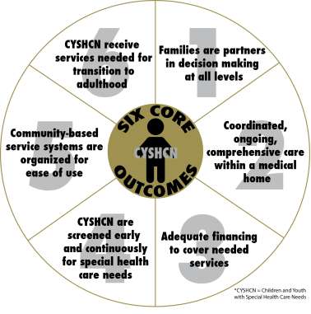
Core Outcomes for CYSHCN

Slide 10
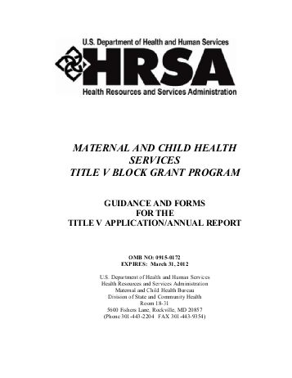
MCH Block Grant
Title V is the largest funding method for MCHB for grantees in 59 states & jurisdictions, providing:
Access to quality care, especially for those with low-incomes or limited availability of care
An increase in health assessments and follow-up diagnostic and treatment services
Access to preventive and child care services as well as rehabilitative services for certain children
Family-centered, community-based systems of coordinated care for children with special healthcare needs
The Block grant was redesigned in 2015, “MCH 2.0,” by MCH Administrator Michael Lu, to:
reduce burden
maintain flexibility
increase accountability of performance & impact
better demonstrate the returns on investment for Title V bettering the health and well-being of mothers, children, and families in the U.S.

Slide 11
Current MCH Block Grant Funding
Each year, Congress sets aside funding for the Maternal and Child Health Block Grant. Individual state portions are then determined by a formula, which considers the proportion of low-income children in a particular state compared to the total number of low-income children in the entire U.S.
States and jurisdictions must match every four dollars of federal Title V money that they receive by at least three dollars of state and/or local money (i.e., non-federal dollars.) Most states overmatch and the resulting funds vary. Typically more than $5 billion is available each year for maternal and child health programs at the state and local levels.
A total of 59 states and jurisdictions receive Title V funding. In FY 2014, states reported reaching over 50 million pregnant women, infants, children—including those with special health care needs—and others, through the Title V Block Grant.

Slide 12
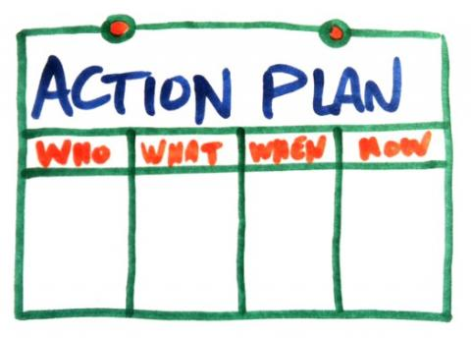
How does it work?
Five year comprehensive needs assessment
Annual needs assessment update
Annual application & annual report to address state & national-identified needs

Slide 13
Vision & Mission of Title V
Section 111. MCH Transformation & revision of MCH Block Grant Application/Annual Report Guidance
Vision of Title V-Title V envisions a nation where all mothers, children and youth including CSHCN and their families are healthy and thriving. (p.3)
Mission of Title V- The mission of Title V is to improve the health and well-being of the nation’s infants, children and youth including youth with special health care needs, and their families. (p.3)

Slide 14
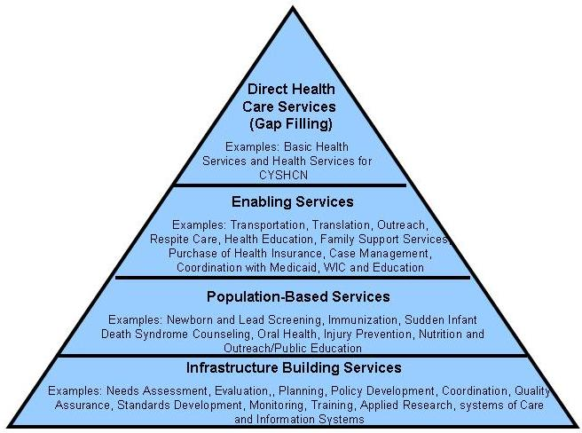
MCH Pyramid

Slide 15
MCH Essential Services
MCH Essential Services (p.3)
1. Provide Access to Care
2. Investigate Health Problems
3. Inform and Educate the Public
4. Engage Community Partners
5. Promote/Implement Evidence-
Based Practices
6. Assess and Monitor MCH Health
System
MCH Essential Services (p.3)
7. Maintain the Public Health
Workforce
8. Develop Public Health Policies and
plans
9. Enforce Public Health Laws
10. Ensure Quality Improvement
Direct Services
Enabling Services
PHS system

Slide 16
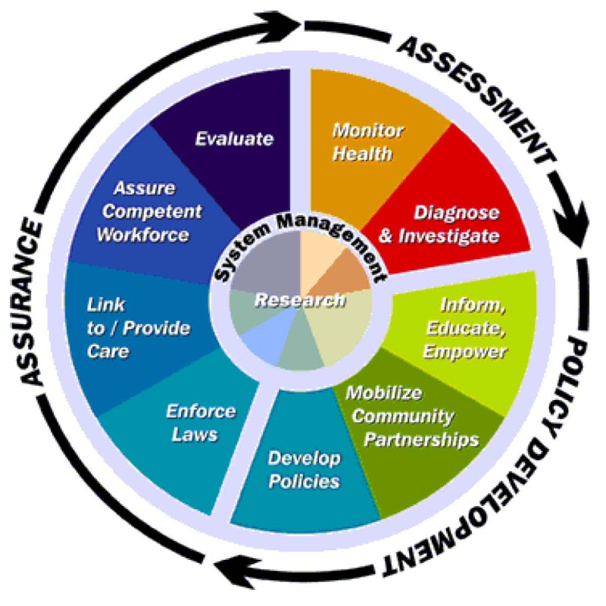

Slide 17
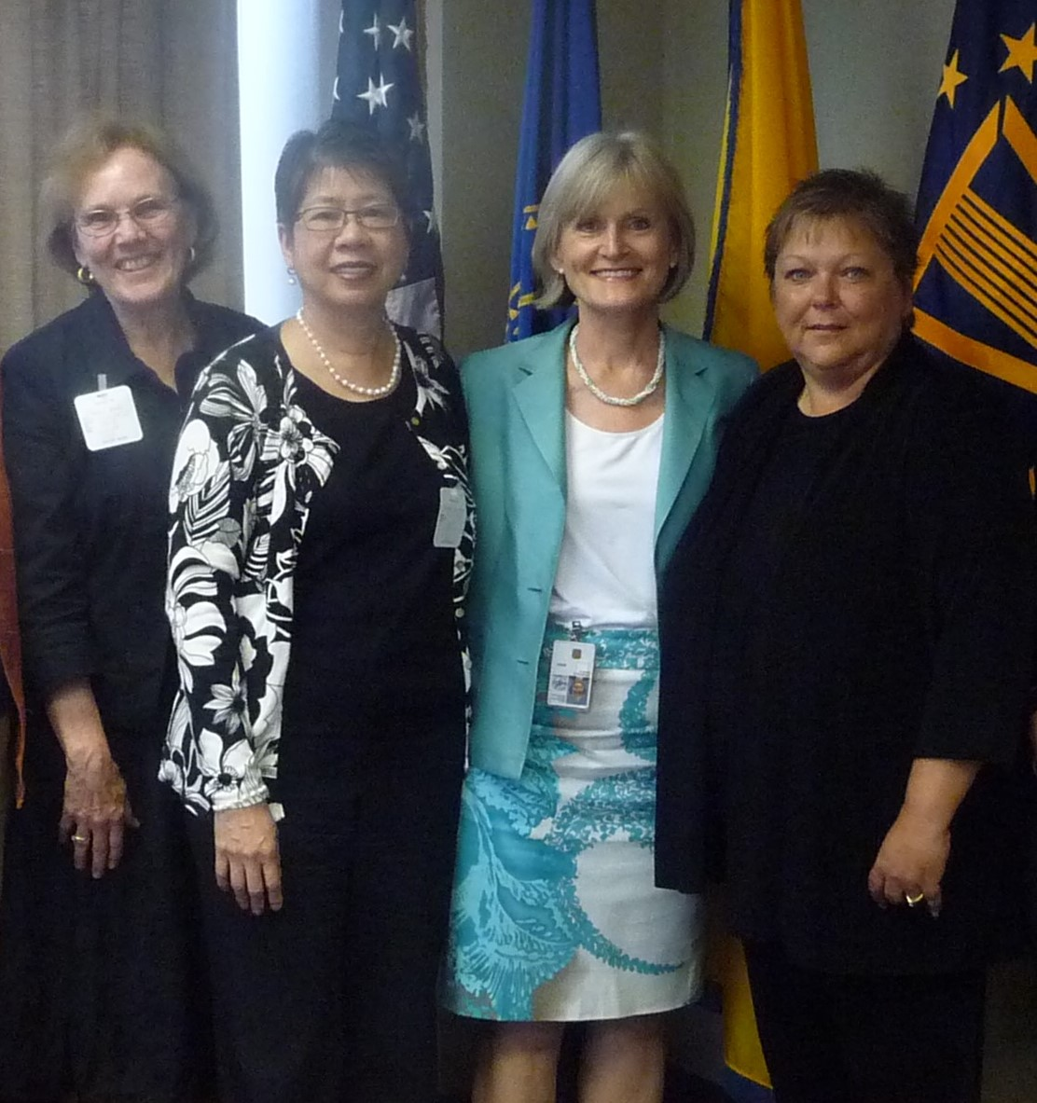
The 10 Essential Public Health Services
These 10 Essential Public Health Services were cross walked with the purpose of the MCH Block Grant to States Program, as defined in Section 501(a)(1) of the Title V of the Social Security Act. The 8 Strategies presented were developed as a result of this effort.
Mobilize partners, including families at the federal, state and community levels in promoting vision for leveraging resources, integrating and improving MCH systems of care, promoting quality public health services and developing supportive polices;
(1 of 8 strategies p. 4)

Slide 18
National Performance Measure Framework p. 4-5
The National Performance Measure system adopted in the guidance includes these measure categories:
National Outcome Measures (NOM’s)
National Performance Measures (NPM’s)
State-initiated Evidence-based or –informed Strategy Measures (ESMs)
The national MCH Priority areas incorporate two significant concepts:
Title V is responsible for promoting the health of all mothers and children, which includes and emphasis on CSHCN and their families.
The development of life course theory-beginning before a child is born and continuing throughout life.

Slide 21
State Requirements
Annual Plan Components:
Executive Summary
State Overview
Needs Assessment Update
Linkage of state priorities with NPMs & State Performance/Outcome measures
State Action Plan table
State Action plan narrative by population domain
Other program activities (next page)
Other sections (next page)
Budget narrative
Reporting forms
Conduct a 5 year Needs Assessment; update it annually
Identify top priority needs
Select at least 8 of 15 National Performance Measures tied to top priority needs
Develop at least 1 Evidence-Based or Evidence-Informed Strategy measure for each NPM
Develop 3-5 State Performance measures
Develop & submit annual plan

Slide 22
Other Program Activities
Other Sections of Report
Partnerships or collaborative roles
Infrastructure building activities
Activities in which the state is involved but does not have a leading role
Note: States are NOT required to complete this section
MCH Workforce Development
MCH Workforce Capacity
Family-Consumer Partnerships
Health Reform – Title V’s role & activities
Emerging issues
Public Input Process
Technical assistance needs

Slide 23
Title V Measurement Framework
Evidence-based Strategy Measure → National Performance Measures → National Outcome Measures
LOGIC MODEL
Process Inputs/Outputs → Short & Medium Term Outcomes → Long-Term Outcomes

Slide 24
Evidence-Based/Informed Strategies
Measurable
Data available or planned to be collected
Valid & reliable
Can show incremental change over time
Meaningful
Related to NPMP & state priority objectives
Based on or informed by evidence of effective practices
Involve stakeholders for input, feedback, & buy-in

Slide 25
National Performance Measure Framework
States should work closely with family/consumer partnerships as they develop the ESMs for their NPMs.
For Purposes of the Title V MCH Services Block Grant Program and the Guidance, Family/ consumer partnership: “The intentional practice of working with families for the ultimate goal of positive outcomes in all areas through the life course.” (P.6)
“Family engagement reflects a belief in the value of family leadership at all levels from an individual, community & policy level.”
Relevant resources include the National Consensus Standards for Systems of Care for CYHCN, released March 2014 report available on the Lucille Packard Website for Children’s Health. Examples of family/consumer partners for Title V organizations are highlighted on the Family Voices website. (P.6)

Slide 26
Changes to the Application/Annual Report Guidance: Needs Assessment Change
The Needs Assessment Summary is integrated into the yearly MCH Block Grant Applications/Annual Reports. (p.6)
States organize the discussion of their Title V program activities for each of the three legislatively-defined MCH populations:
Preventive and primary care services for pregnant women, mothers, and infants up to age 1
Preventive and primary care services for children; and
Services for CSHCN) in the context of these six identified MCH population health domains. (p. 6)
At least 30% of block grant funds must be spent on children, and at least 30% must be spent on CSHCN

Slide 27
Needs Assessment-Executive Summary
The Executive Summary briefly describes the key points presented in the states’ Application/Annual Report and include, at a minimum:
Emergent needs based on the Five-year/ongoing needs assessment efforts & linked with the Title V program priorities and development of a five-year State Action Plan;
Highest ranked priority needs for the state Title V program, including a discussion of key SPMs and ESMs which the state developed to address, respectively, the identified priority needs and selected NPMs; and
Accomplishments relative to addressing the identified needs and a plan for the coming year that assures continued progress in achieving the desired health status and performance outcomes (P.7)

Slide 28
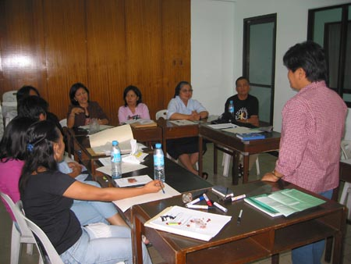
Executive Summary
In addition to providing a summary overview of the state Title V program and the gains that have been realized relative to the state priority needs, the Executive Summary can serve as a stand-alone document for the state in marketing its Title V programs achievements to other, state, community and family agencies and in soliciting programmatic input from families and other MCH stakeholders. (p.7)

Slide 29
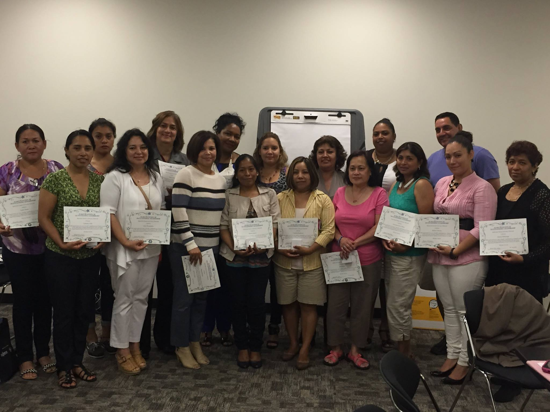
Five-Year needs Assessment Summary iii MCH workforce Development & Capacity (p.23)
(b) Provide examples of the mechanisms that the state has developed and utilized to promote and provide culturally competent approaches in its service delivery.
(2) Ensure the provision of training, both in orientation and ongoing professional development, for staff, family leaders, volunteers, contractors and subcontractors in the area of cultural and linguistic competence.
(3) Collaborate with informal community leaders/groups (e.g. natural networks, informal leaders, spiritual leaders, ethnic media and family advocacy groups) and families of culturally diverse groups in needs/assets assessments, program planning, service delivery and evaluation/monitoring/quality improvement activities.

Slide 30
Five-Year needs Assessment Summary iii MCH workforce Development & Capacity (p.26)
C. State Selected Priorities
List the seven to ten highest priority needs they identified based on the finding of the Five-Year Needs Assessment (Form 9).
Provide a rationale for how these priority needs were determined. This rationale should include pertinent discussion on other priority needs that were strongly considered by the state and its stakeholders and why these needs were not included among the final priority list.
Describe the methodologies that were used for ranking the broad set of defined needs and the process for selecting its final seven to ten priorities.

Slide 31
Five-Year needs Assessment Summary iii MCH workforce Development & Capacity (p.23-24)
C. Partnerships, Collaboration and Coordination
Describe relevant organizational relationships which serve the legislatively-defined MCH populations and contribute to, or expand, the capacity and reach of the State Title V and CSHCN programs.
Focus on the partnerships, collaborations, and cross-program coordination established by the state Title V program with public and private sector entities: federal, state & local government programs, Tribes, Tribal Organizations, & Urban Indian organizations, families/consumers; primary care associations, tertiary care facilities’ academia and other primary and public health organizations across the state that address the priority needs of the MCH population but are not funded by the state Title V program.

Slide 32
Five-Year needs Assessment Summary iii MCH workforce Development & Capacity (p.24-25)
In reporting on the Title V programs ongoing commitment and efforts to build sustain and expand partnerships, to work collaboratively and to coordinate relationships with such programs as: (out of the 10 points vii. and ix. Involve family/consumers. (p.25)
Vii. Tribes, Tribal Organizations and Urban Indian Organizations
ix. Family/consumer partnership and leadership programs

Slide 33
Five-Year needs Assessment Summary iii MCH workforce Development & Capacity (p.25)
Include qualitative and quantitative information on their established family/consumer partnerships.
i. Nature & substance of the established family/consumer partnership;
ii. Diversity of members engaged in the family/consumer partnership;
iii. Number of families/consumers engaged in the family/consumer partnership, the degree of their engagement, the compensation that is provided to them and the number of family/consumers that were trained on MCH core competencies;

Slide 34
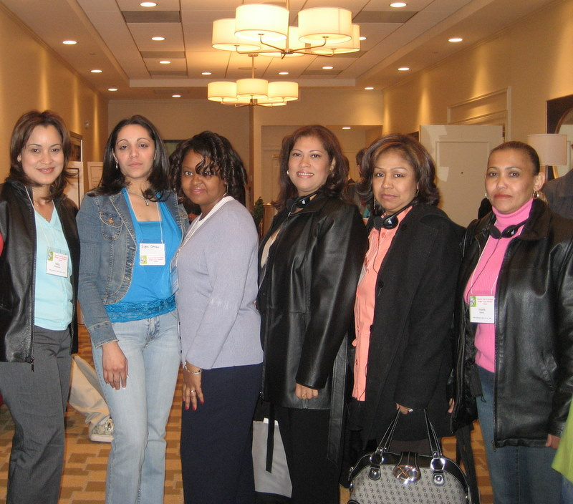
Five-Year needs Assessment Summary iii MCH workforce Development & Capacity (p.25)
iv. Evidence and range of issues being addressed through the family/consumer partnership;
v. Impact of family/consumer partnership on programs and policies, including the development of promising practices and;
vi. Description of the state’s efforts to build and strengthen family consumer partnerships for all MCH populations, including CSHCN

Slide 35
Five-Year needs Assessment Summary iii MCH workforce Development & Capacity (p.26)
Discuss factors that have contributed to changes in the priority needs since the previous five-year reporting cycle and note if priorities were:
(1) Continued.
(2) Replaced; or
(3) Added.
For each priority need the state should discuss why a priority need was continued, replaced or added.

Slide 36
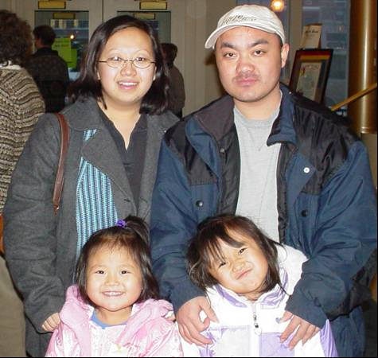
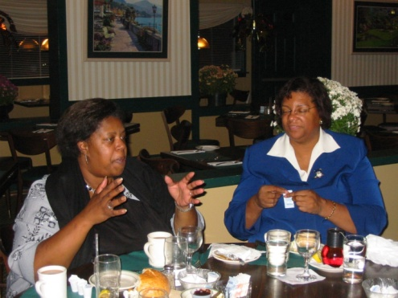
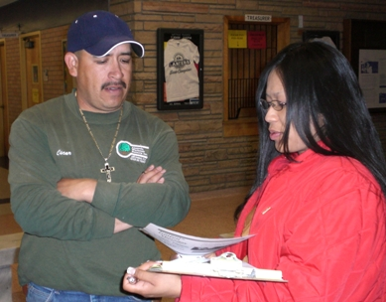
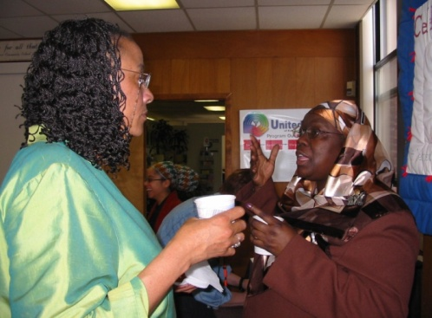
Family/Consumer Partnership (p.33)
Include a description of the state’s efforts and initiatives to build and strengthen family/consumer partnerships for all MCH populations, to assure cultural and linguistic competence, & to promote health equity in the work of the of the state Title V program.
Family/consumer partnership is “the intentional practice of working with families for the ultimate goal of positive outcomes in all areas through the life course.”
Notes:
Building the capacity of women, children, children and youth including those with SHCN and families to partner in decision making with Title V programs at the federal, state, and community levels is a critical strategy in helping states to achieve national outcomes.

Slide 37
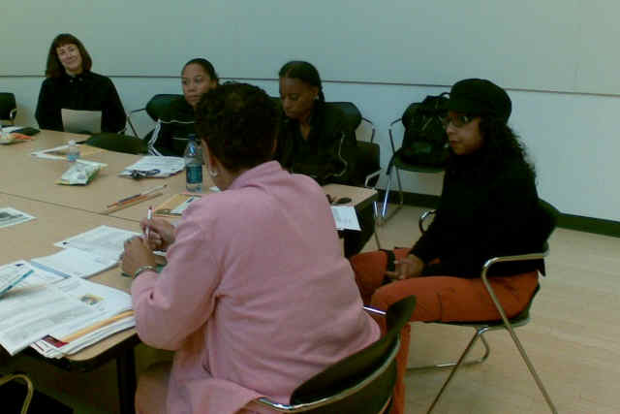
Family/Consumer Partnership (p.33-34)
Family engagement reflects a belief in the value of the family leadership at all levels from an individual, community and policy level.” States will describe efforts to support Family/Consumer Partnerships, including family/consumer engagement in the following strategies and activities:
Advisory Committees;
Strategic and Program Planning;
Quality Improvement
Workforce Development
Block Grant Development and Review
Materials Development; and
Advocacy.

Slide 38
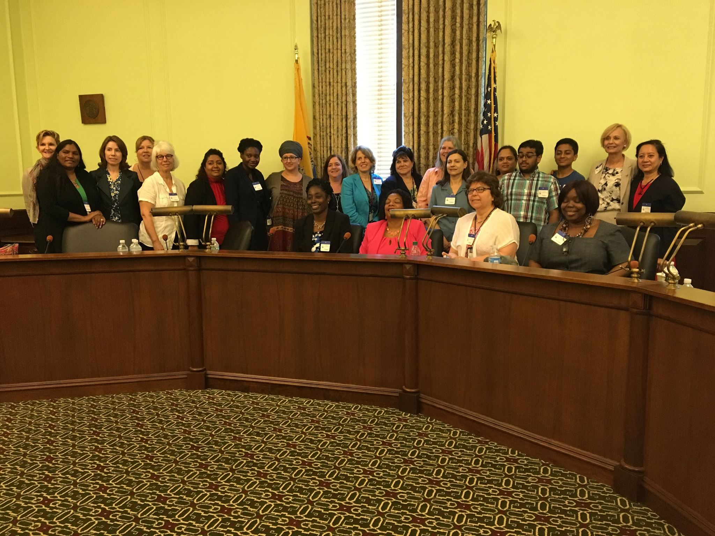
Public Input [section 505a] (p.34)
In its Application/Annual Report, the state shall describe:
The process for making the Application/Annual Report available to the public for comment during its development and after its transmittal
The number and nature of the comments received and how they were addressed

Slide 39
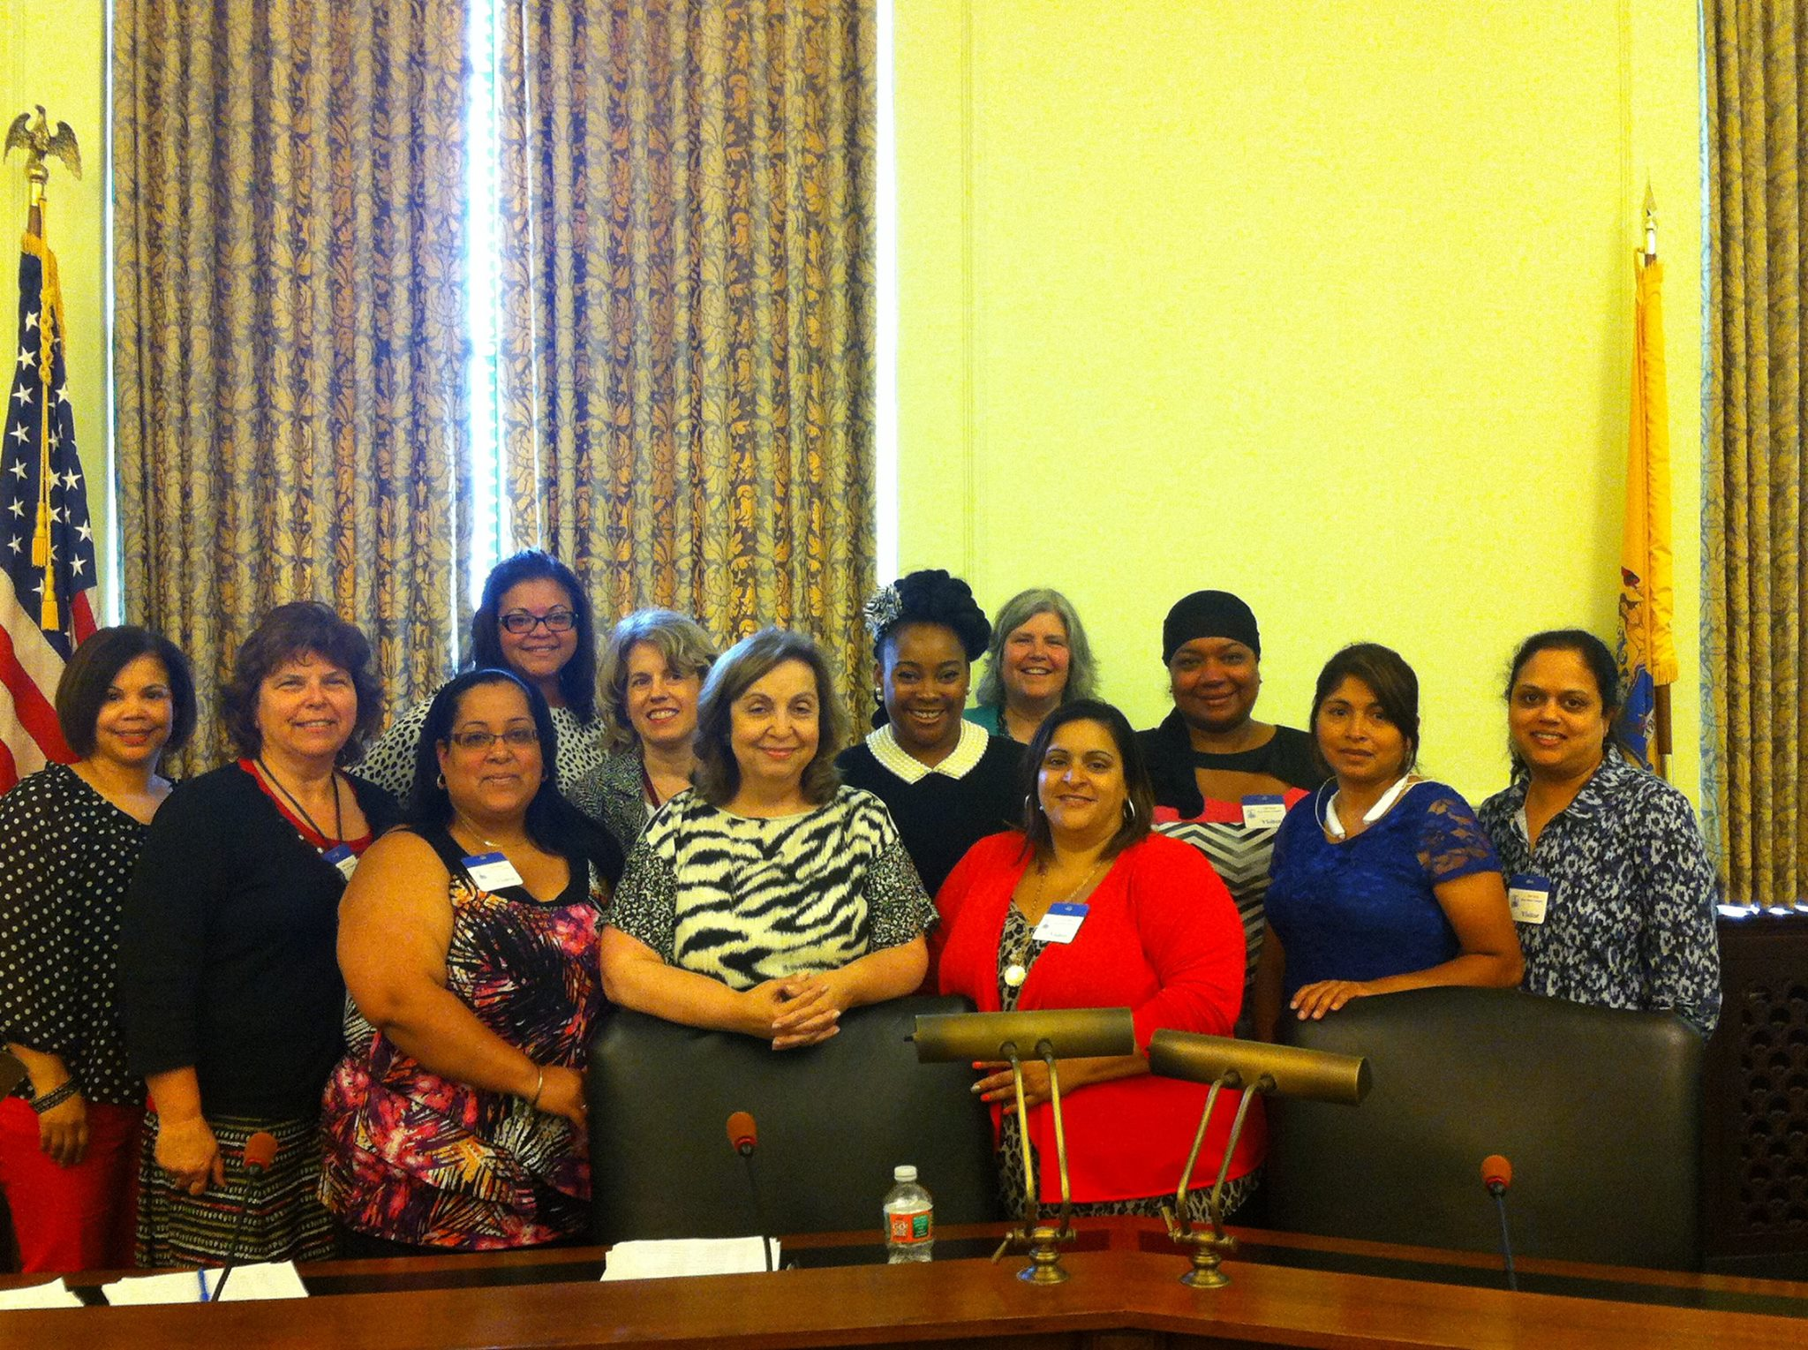
Public Input [section 505a] (p.35)
The state should clearly identify specific activities for engaging families and other stakeholders prior to, during and after the Application process. Such activities may include:
Public Hearings
Advisory Council Review
Web Posting
Social Media
Public notices
Other use of media
Outreach to specific stakeholders
Further information regarding public input can be found by opening the section titled “Technical Assistance to States” on the MCHB website, http://www.mchb.hrsa.gov See the resource document entitled” Facilitating Public Comment on the Title V Block Grant.

Slide 40
Block Grant Review
Each state & territory attends a Block Grant Review to “defend” their Block Grant application
NJ Team includes Assistant Commissioner for Family Health Services, Director of MCH Division with team members, Director of Special Child Health & Early Intervention Services with team members, & representative of SPAN
Review team includes reviewers with expertise in running MCH programs at state & local levels; representative of MCH from the appropriate region; & in some instances, family leader representative
Reviewers use a template to review the application, comment on strengths & challenges, & determine if there are any required actions the state must take
States have opportunities to make changes based on reviewer comments
Final application is approved by MCHB project officer

Slide 41
Questions?

